Slide 1

Thursday, September 28th, 2023
WELCOME TO OUR CLASS
Unit 2 : City life
P10. Lesson 2: A closer look 1

Slide 2
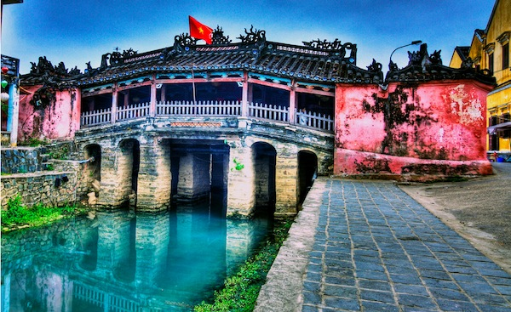
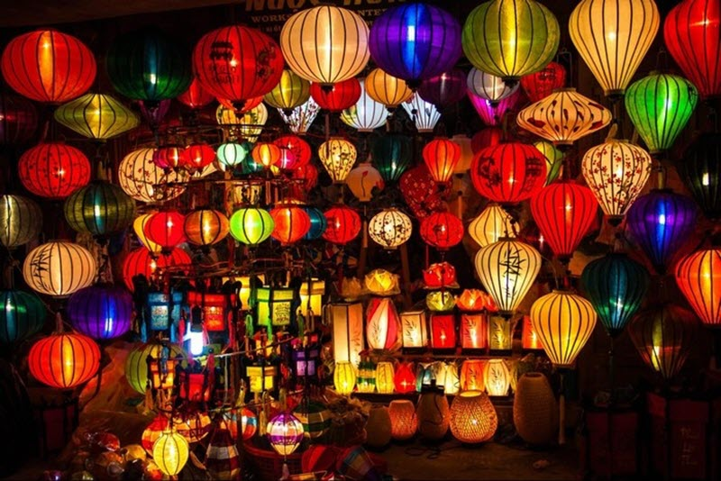
WARM-UP
* What place are these pictures about?
They’re about Hoi An

Slide 3

I. Vocabulary:
hấp dẫn, quyến rũ
- 1. fascinating (adj):
2. forbidden (adj):
3. populous (adj):
4. cosmopolitan (adj):
5. downtown (adj, n):
- 6. affordable (adj) :
bị cấm
đông dân
khắp thế giới
(thuộc) khu thương mại
(giá cả) phải chăng

Slide 4
* Checking the words :
What and Where
fascinating
1
downtown
5
forbidden
2
affordable
6
cosmopolitan
4
populous
3

Slide 5
1a. Put one of the adjectives in the box in each blank
local delicious ancient historic
helpful warm fascinating comfortable
Dear Oggy,
We’re having a fabulous time here in Hoi An. You know, it’s a(n) (1) _________ town 30 km from Da Nang. The weather is very (2) _________ and sunny. Our hotel is small but (3) ___________. The staff are friendly and (4) __________ .
We’ve seen most of the sights of the town. The street life here is (5) ___________ . We’ve spent a lot of time wandering around and looking at the (6) _________ temples, bridges, and houses. We’ve also bought a lot of (7) _________ souvenirs, crafts, and clothing. Well, the street food in Hoi An is (8) _________ and affordable. I wish you could be here with us!
Anyway, I hope things are good with you.
Lots of love,
Jack
ancient
warm
comfortable
helpful
fascinating
historic
local
delicious
1b. Underline all the other adjectives in the letter.

Slide 6
2. Which of the following adjectives describe city life? Put a tick (√).
1.stressful
2.exciting
3.delicious
4.historic
5.busy
6.forbidden
7.exhausted
8.modern
9.frightening
10.rural
√
√
11.populous
12.polluted
13.cosmopolitan
14.unemployed
15.annoying
16.pleased
17.cheerful
18.easy-going
19.downtown
20.fashionable
√
√
√
√
√
√
√
√
√
√
√

Slide 7

She lives in one of the most ………………. parts of the city: there are lots of luxury shops there.
How ……………… ! The roads are crowded and I’m stuck in a traffic jam.
You can’t stop here. Parking is ………………… in this street.
This city is very ……………………, there are people here from all over the world.
The gallery downtown has regular exhibitions of …………………. art.
Nhieu Loc canal in Ho Chi Minh City is much less ………………….. Than before.
fashionable
annoying
forbidden
cosmopolitan
modern
polluted

Slide 8
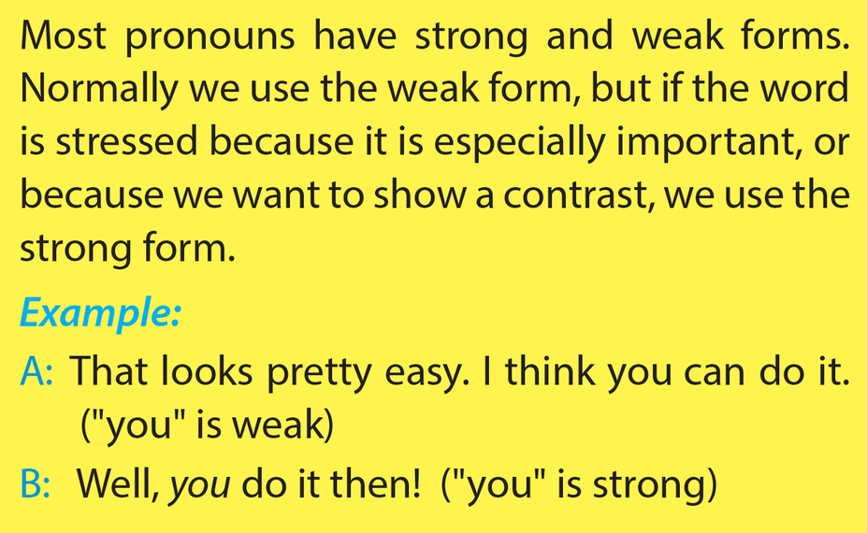
II. Pronunciation:
Stress on pronouns in sentences

Slide 9

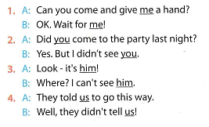
(me is weak)
(you is weak)
(him is weak)
(us is weak)

Slide 10

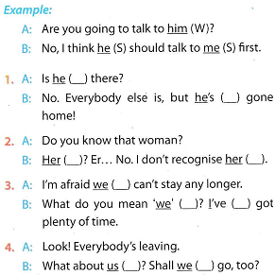
W
S
S
W
W
S
S
S
W
5b. Work in pairs. Practise the exchanges above.

Slide 11
III. Consolidation
1. The Adjectives connected with cities and city life:
modern
…
busy
historical
Adjectives
fashionable
convenient
expensive
polluted
exciting

Slide 12
Consolidation
2. Stress on pronouns in sentences
- A pronoun is stressed because :
+ It’s especially important
+ We want to show a contrast

Slide 13
IV. Homework
Learn by heart the new words.
Practise the pronunciation at home
3.Do the exercises in the notebooks
4.Prepare Unit 2 : A Closer look 2.

