Slide 2
Unit
3
COMMUNITY SERVICE
LESSON 3: A CLOSER LOOK 2
Unit

Slide 3
OBJECTIVES
By the end of the lesson, students will be able to:
understand the use of the past simple tense
practise using the past simple tense in contexts

Slide 4
LESSON 3: A CLOSER LOOK 2
WARM-UP
Chatting
PRESENTATION
The past simple tense
Task 1: Circle the correct answer A, B, or C to complete each sentence.
Task 2: Complete the sentences the the past simple form of the given verbs.
Task 3: Complete the sentences with the correct forms of the verbs from the box.
Task 4: Write complete sentences from the prompts.
PRACTICE
PRODUCTION
Task 5: The Red Cross in 2016 and 2020
CONSOLIDATION
Wrap-up
Homework

Slide 5
LESSON 3: A CLOSER LOOK 2
WARM-UP
Chatting
Aims of the stage:
To activate activate students’ prior knowledge related to the targeted grammar: the past simple

Slide 6
WARM-UP
What did you do last weekend?
What did you watch yesterday?
Who did you meet two days ago?

Slide 7
LESSON 3: A CLOSER LOOK 2
WARM-UP
Chatting
PRESENTATION
The past simple tense

Slide 8
PRESENTATION

Slide 9
LESSON 3: A CLOSER LOOK 2
WARM-UP
Chatting
PRESENTATION
The past simple tense
Task 1: Circle the correct answer A, B, or C to complete each sentence.
Task 2: Complete the sentences the the past simple form of the given verbs.
Task 3: Complete the sentences with the correct forms of the verbs from the box.
Task 4: Write complete sentences from the prompts.
PRACTICE

Slide 10
- Chúng ta dùng thì quá khứ đơn để nói về các hành động đã hoàn thành trong quá khứ. - Các cụm từ chỉ thời gian như: yesterday(hôm qua), last month (tháng vừa rồi), three weeks ago(cách đây ba tuần) hoặc in 1999 (thời điểm xác định trong quá khứ) với thì quá khứ đơn.

Slide 11
PRACTICE
1
Circle the correct answer A, B, or C to complete each sentence.
1. Green School ______ vegetables for an orphanage last spring. A. is growing B. grew C. grows 2. Children ______ plastic bottles for recycling a month ago. A. are collecting B. collect C. collected 3. We ______ English to children in a primary school last summer. A. are teaching B. taught C. teach

Slide 12
PRACTICE
1
Circle the correct answer A, B, or C to complete each sentence.
4. Our school club ______ gloves for old people in nursing homes last winter. A. made B. is making C. make 5. We ______ bottles to help the environment last month. A. are reusing B. reuse C. reused

Slide 13
PRACTICE
2
Complete the sentences the the past simple form of the given verbs.
took
1. Care for Animals (take) _______ care of thousands of homeless dogs and cats last year. 2. ___________ teenagers (join) ___________ Lending Hand in 2015? 3. We (help) ___________ the elderly in a village last summer. 4. Last year, we (send) ___________ textbooks to help children in a rural village. 5. Tom (volunteer) ______________ to teach English in our village last winter.
Did
join
helped
sent
volunteered

Slide 14
PRACTICE
3
Complete the sentences with the correct forms of the verbs from the box.
1. The club members _____________ food for patients every Sunday. 2. ________ you _____________ those trees in the playground last month? 3. Nick and his friends _________________ rubbish on the beach now. 4. Tom ______________ the plastic bottles, and now he has some nice vases. 5. We often ____________ books to old people in a nursing home.
cook
Did
plant
are picking up
recycled
read

Slide 15
PRACTICE
4
Write complete sentences from the prompts.
1. last year / our club / donate / books / children in rural areas. _____________________________________________________ 2. children / send / you thank-you cards / a week ago? _____________________________________________________ 3. I / teach / two children in grade 2 / last summer. _____________________________________________________ 4. Last spring / we / help / the elderly / nursing home. _____________________________________________________ 5. How / you / help / people / in flooded areas / last year? _____________________________________________________
Last year, our club donated books to children in rural areas.
Did children send you thank-you cards a week ago?
I taught two children in grade 2 last summer.
Last spring, we helped the elderly in a nursing home.
How did you help the people in flooded areas last year?

Slide 16
LESSON 3: A CLOSER LOOK 2
WARM-UP
Chatting
PRESENTATION
The past simple tense
Task 1: Circle the correct answer A, B, or C to complete each sentence.
Task 2: Complete the sentences the the past simple form of the given verbs.
Task 3: Complete the sentences with the correct forms of the verbs from the box.
Task 4: Write complete sentences from the prompts.
PRACTICE
PRODUCTION
Task 5: The Red Cross in 2016 and 2020

Slide 17
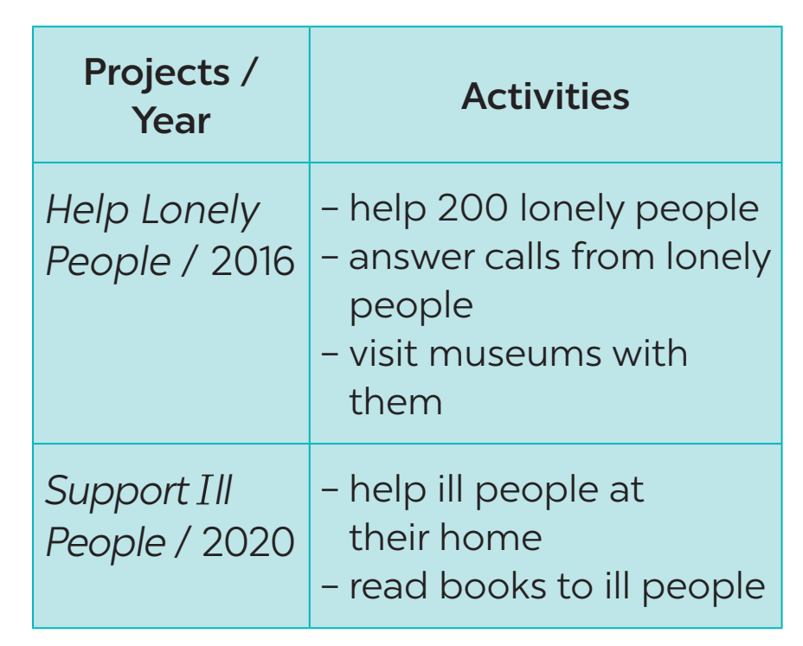
PRODUCTION
5
The Red Cross in 2016 and 2020
Tom is from the Red Cross. Look at the fact sheet and ask Tom about his projects in 2016 and 2020.
Example: Tom: I’m from the Red Cross. I worked on the Help Lonely People project in 2016. Lan: What did you do? Tom: We helped 200 lonely people …

Slide 18
LESSON 3: A CLOSER LOOK 2
WARM-UP
Chatting
PRESENTATION
The Past Simple tense
Task 1: Circle the correct answer A, B, or C to complete each sentence.
Task 2: Complete the sentences the the past simple form of the given verbs.
Task 3: Complete the sentences with the correct forms of the verbs from the box.
Task 4: Write complete sentences from the prompts.
PRACTICE
PRODUCTION
Task 5: The Red Cross in 2016 and 2020.
CONSOLIDATION
Wrap-up
Homework

Slide 19
CONSOLIDATION
1
WRAP-UP

Slide 20
CONSOLIDATION
2
HOMEWORK
Complete exercises in the Workbook.

Slide 21
Website: sachmem.vn
Fanpage: facebook.com/sachmem.vn/

