Slide 2
Unit
4
ETHNIC GROUPS OF VIET NAM
Unit
ETHNIC GROUPS OF VIET NAM
LESSON 3: A CLOSER LOOK 2
LESSON 3: A CLOSER LOOK 2
Unit
HOBBIES

Slide 3
Who’s faster?
Gong
Communal house
Topic:
Ethnic groups of Viet Nam
Wooden statue
Terraced field
Folk dance
Musical instrument
Bamboo house
Costume
Five-colour sticky rice
Stilt house

Slide 4
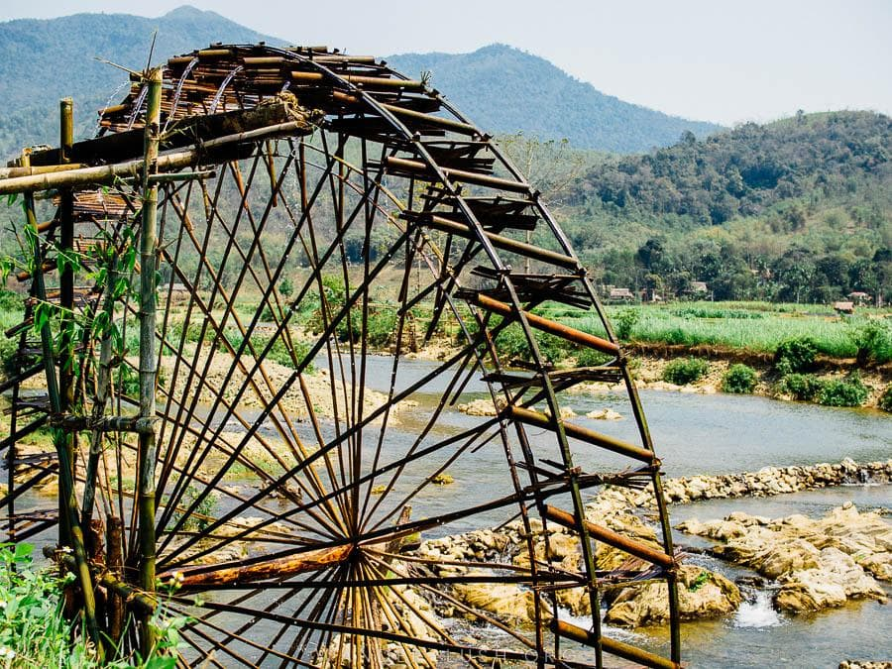
VOCABULARY
waterwheel (n)
/ˈwɔːtəwiːl/
bánh xe nước

Slide 5
I. GRAMMAR:
1. Yes/ No questions:
* Form: Trợ động từ + chủ ngữ (S) + động từ + ….?
- Trợ động từ: to be, do, does,did, have/has, will, can ....
Ex: 1. Are you a good student ?
2. Does she like cooking ?
3. Have you ever seen terraced fields ?
4. Can you play the guitar ?

Slide 6
2. Wh- questions:
* Form: Wh- word + trợ động từ + chủ ngữ (S) + động từ + ….?
- Wh- words: what, why, where,when, how, which, who
Ex: 1. Where do the Kmer live ?
2. How many ethnic groups are there in Viet Nam ?

Slide 7
YES / NO AND WH-QUESTION
1
Change the sentences into Yes / No questions.
1. Women play an important role in a Jrai family.
→ Do women play an important role in a Jrai family?
2. Mua sap is a popular folk dance of the Thai people.
→ Is mua sap a popular folk dance of the Thai people?

Slide 8
YES / NO AND WH-QUESTION
1
Change the sentences into Yes / No questions.
3. We didn’t have boarding schools for minority students in 1950.
→ Did you have boarding schools for minority students in 1960?
4. I attended the Ban Flower Festival in Dien Bien last year.
→ Did you attend the Ban Flower Festival in Dien Bien last year?
5. We will watch a documentary about the Khmer.
→ Will you watch a documentary about the Khmer?

Slide 9
YES / NO AND WH-QUESTION
2
Choose the correct question word for each question below.
1. A: ______ do you like best about Sa Pa?
B: I like its local markets best.
A. Why B. What
2. A: ______ can we find the most beautiful terraced fields?
B: In Mu Cang Chai.
A. When B. Where
3. A: ______ is the Ban Flower Festival?
B: It’s in spring.
A. When B. Why

Slide 10
YES / NO AND WH-QUESTION
2
Choose the correct question word for each question below.
4. A: ______ tall is an average stilt house?
B: About 5 - 6 metres tall.
A. How B. What
5. A: ______ festival is more important for the Kinh: the Mid-Autumn or the Lunar New Year?
B: The Lunar New Year.
A. What B. Which

Slide 11
3. Countable noun: danh từ đếm được
- Danh từ đếm được: bao gồm các danh từ có thể kết hợp số đếm. Đó có thể là danh từ chỉ người, vật, động vật, nơi chốn, ý tưởng… Countable noun có thể ở dạng số ít và dạng số nhiều.
Ex:
A dog – Two dogs;
An idea – Two ideas;

Slide 12
4. Uncountable noun: danh từ không đếm được
- Danh từ không đếm được : bao gồm các danh từ không thể kết hợp với số đếm. Đó có thể là danh từ chỉ khái niệm trừu tượng, tính chất và các vật thể quá nhỏ hoặc không có hình dạng nhất định… Uncountable noun luôn ở dạng số ít.
Ex: Knowledge; Beauty; Fear; Coffee; Sugar; Air.

Slide 13
COUNTABLE AND UNCOUNTABLE NOUNS
3
Write C (countable) or U (uncountable) for the underlined words.
Some minority (1) groups are farmers. They do not have much (2) land and they use simple farming techniques. After finding an (3) area for a garden, the men cut the (4) trees down and burn them. The (5) ash they collect helps enrich the soil. They then grow a few (6) crops like rice and corn.
____
2. ____
3. ____
4. ____
5. ____
6. ____
C
U
C
C
U
C

Slide 14
5. Quantifiers: từ chỉ số lượng trong tiếng Anh:
a/an + countable noun ( số ít)
some + countable noun( số nhiều) / uncountable noun
many + countable noun ( số nhiều)
much + uncountable noun
A lot of/ Lots of + countable noun( số nhiều) / uncountable noun
A little / Little + uncountable noun
A few /Few + countable noun( số nhiều)

Slide 15
COUNTABLE AND UNCOUNTABLE NOUNS
4
Fill in the blank with a, much, many, a little, or a few.
1. My uncle has _____coffee plantation in Kon Tum.
2. How _______ ethnic groups live on the Hoang Lien Son mountain range?
3. There are only _______ waterwheels left in my village.
4. You should add ________ more water to your noodles. It’s a bit dry.
5. How ______ information about the Van Kieu have you collected?
a
many
a few
a little
much

Slide 16
Choose the correct answer:
1........... there any restaurants still open near here ?
A
Do
B
Does
C
Are
C
Are
D
Is

Slide 17
2. ................. is it from the boarding school to
the ethnic children village ?
A
How often
B
How much
C
How long
D
How far
D
How far

Slide 18
3. If you pay .............. attention to the costume
of the Pa Then girls, you will see that the dress shirt is
unique
a little
A
A
a little
B
many
C
a
D
a few

Slide 19
4. He introduced us to some friends of his
A
B
friends is an uncountable noun
C
C
friends is a countable noun
friends is a countable noun
D

Slide 20
5.I read the news on the internet
A
news is a countable noun
B
news is an uncountable noun
B
news is an uncountable noun
C
D
Notes:
t

Slide 21
CONSOLIDATION
1
Wrap-up
Grammar: - Yes / No and Wh-questions
- Countable and uncountable nouns

Slide 22
CONSOLIDATION
2
Homework
- Learn by heart all the words.
- Do exercises in the workbook.
- Prepare for Lesson 4 – Communication.

Slide 23
Website: hoclieu.vn
Fanpage: facebook.com/www.tienganhglobalsuccess.vn/

