Slide 2
WARM-UP
Villa
Types of house

Slide 3
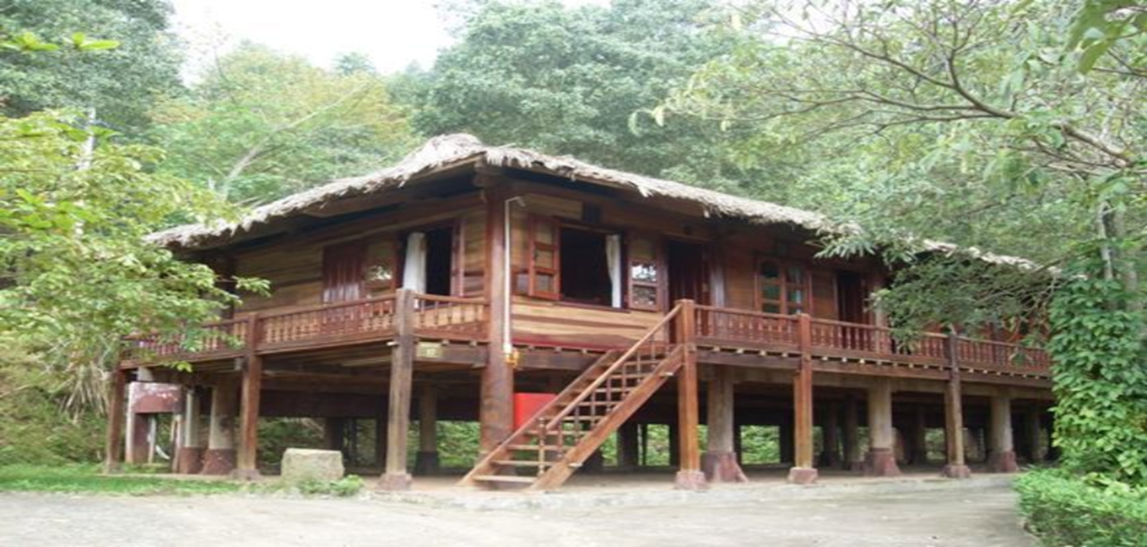
Unit
4
ETHNIC GROUPS OF VIET NAM
Unit
ETHNIC GROUPS OF VIET NAM
LESSON 5: SKILLS 1
LESSON 3: A CLOSER LOOK 2
Unit
HOBBIES

Slide 6
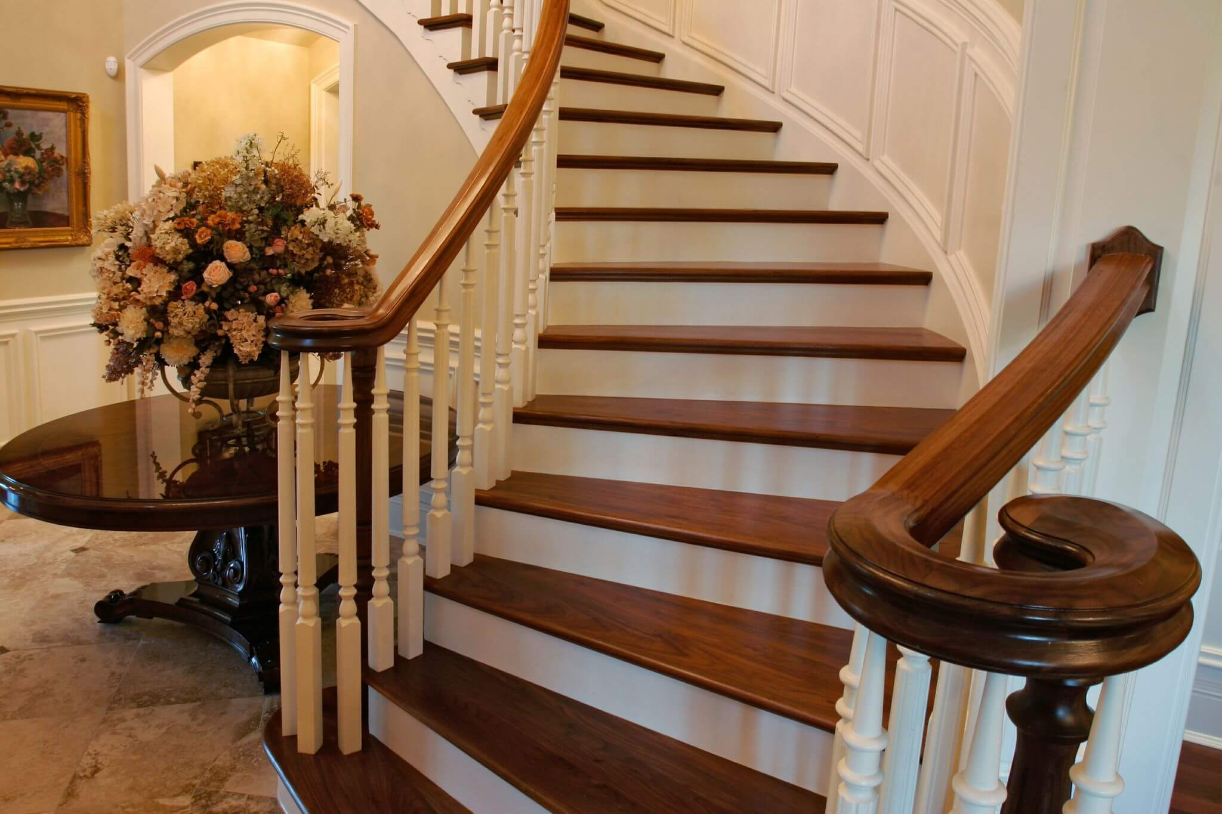
VOCABULARY
staircase (n)
/ˈsteəkeɪs/
cầu thang bộ

Slide 7
VOCABULARY
material (n)
/məˈtɪəriəl/
vật liệu

Slide 8
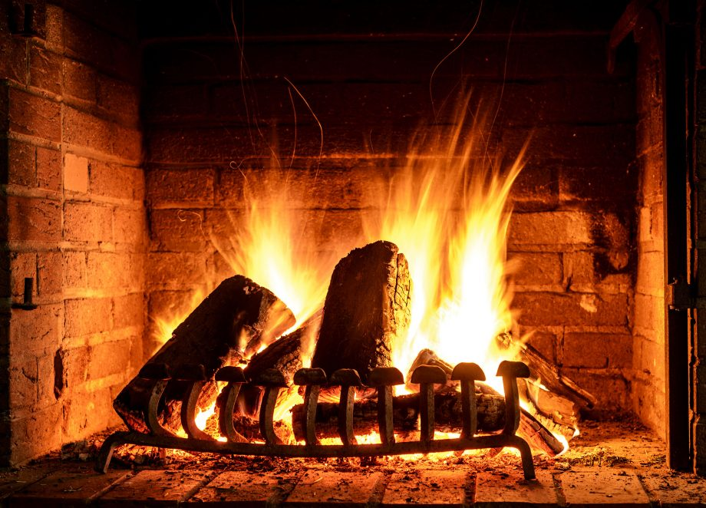
VOCABULARY
open fire (n)
/ˌəʊpən ˈfaɪə/
lò sưởi, bếp lửa

Slide 9
VOCABULARY
owner (n)
/ˈoʊnə/
người sở hữu, chủ

Slide 10
VOCABULARY
New words | Pronunciation | Meaning
1. staircase (n) | /ˈsteəkeɪs/ | cầu thang bộ
2. material (n) | /məˈtɪəriəl/ | vật liệu
3. open fire (n) | /ˌəʊpən ˈfaɪə/ | lò sưởi, bếp lửa
4. owner (n) | /ˈoʊnə/ | người sở hữu, chủ

Slide 11
VOCABULARY
New words |  | Meaning
1. staircase (n)
2. material (n)
3. open fire (n)
4. owner (n)
vật liệu
người sở hữu, chủ
cầu thang bộ
lò sưởi, bếp lửa

Slide 12
READING
1
Write the words and phrase from the box under the correct pictures.
open fire
posts
staircase
1. _______________
2. _______________
3. _______________

Slide 13
Stilt houses
Stilt houses are popular among different ethnic minority groups, from the Thai in the Northern Highlands to the Khmer in the Mekong Delta. The houses come in different sizes and styles, and show the traditional culture of their owners.
Stilt houses are made from natural materials like wood, bamboo, and leaves. They stand on strong posts, about two or three metres above the ground. This allows them to keep people safe from wild animals. People climb a seven- or nine-step staircase to enter the house. The most important place in the house is the kitchen. It has an open fire in the middle of the house. It is the place for family gatherings and receiving guests.
The stilt houses of the Tay and Nung usually overlook a field. The stilt houses of the Thai, however, face mountains or a forest. The Bahnar and Ede have a communal house (called a Rong house) as the heart of their village. These communal houses are the largest and tallest ones in the village.

Slide 14
READING
2
Read the passage and tick T (True) or F (False)
Statements | True | False
1. Only a few minority groups live in stilt houses.
2. All stilt houses look alike.
3. Family gatherings take place by the open fire in the middle of the house.
4. The Rong house serves as the centre of an Ede village

Slide 15
1.Only a few minority groups live in stilt houses. - F
Stilt houses are popular among diferent ethnic groups, from the Thai in the Northern Highlands to the Khmer in the MeKong Delta.

Slide 16
2. All stilt houses look alike - F
The houses come in diferent sizes and styes, and show the traditional culture of their owners.

Slide 17
3. Family gatherings take place by the open fire in the middle of the house - T
The most important place in the house is the kitchen. It has an open fire in the middle of the house. It is the places for family gatherings and receiving guests.

Slide 18
4. The Rong house serves as the centre of an Ede village - T
The Bahnar and Ede have a communal house ( called a Rong house) as the heart of their village.

Slide 19
READING
3
Read the passage again and fill in each blank with one word.
traditional
1. A stilt house shows the _________ culture of the owner.
2. The Tay’s and Nung’s stilt houses overlook a _________.
field
forest
3. The Thai’s stilt houses overlook a _________ or __________.
mountains
4. The largest and tallest house in an Ede village is the _________ house.
Rong

Slide 20
SPEAKING
USING MIND MAP TO SUMMARIZE SOME MAIN IDEAS ABOUT STILT HOUSE

Slide 21
PROJECT:
SPEAKING
SPEAKING ABOUT OUR ETHNIC GROUPS

Slide 22
CONSOLIDATION
1
Wrap-up
In this lesson, you have:
learnt new words related to the topic of stilt house.
read a passage about stilt houses.
described the house you live in.

Slide 23
CONSOLIDATION
2
Homework
Learn by heart all the new words.
Do exercises in the workbook.
Prepare for Lesson 6 – Skills 2.

Slide 24
Website: hoclieu.vn
Fanpage: facebook.com/www.tienganhglobalsuccess.vn/

