Slide 1
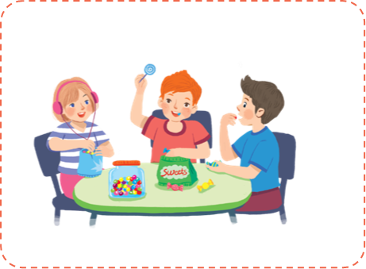
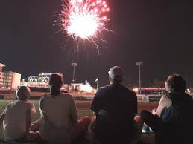
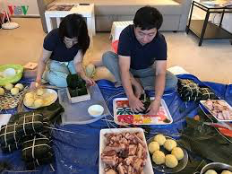
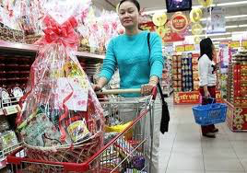
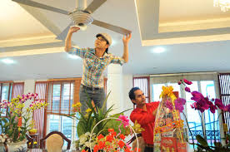
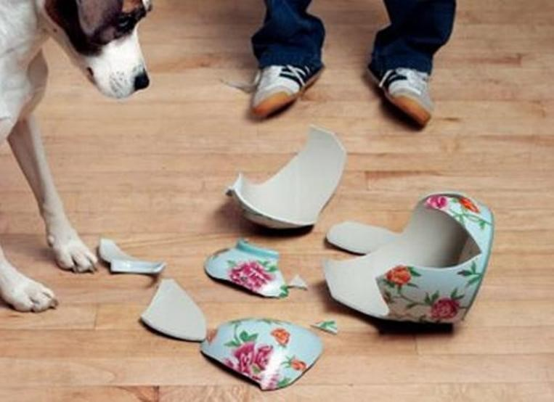
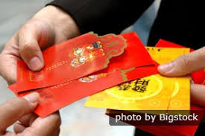
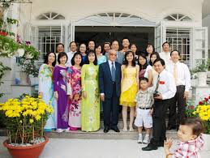
* WARM UP
Activities you should do/ shouldn’t do at Tet
Notes:
Listing activities they will do

Slide 2
ENGLISH 6
UNIT 6: OUR TET HOLIDAY
P47.LESSON 7

Slide 3
Match the verbs on the left with the nouns on the right.
1.
give
a.
a wish
1 - d
give lucky number
2.
cook
b.
fireworks
2 - c
cook special food
3.
plant
c.
special food
3 - e
plant trees
4.
make
d.
lucky number
4 - a
make a wish
5.
watch
e.
trees
5 - b
watch fireworks
6.
break
f.
things
6 - f
break things

Slide 4
Complete the sentences with the words / phrases in the box.
gathering
cleaning
lucky money
banh chung
peach
1.
At Tet, my mother puts
lucky money
into red envelopes.
2.
What are you doing?
I’m
my bedroom.
cleaning
Banh chung
3.
is special for Tet.
peach
4.
We have flowers only at Tet.
5.
When everybody is at home together,
we call it a family
gathering.
.

Slide 5
*Grammar
Write full sentences using the cues given, and should or shouldn’t.
1.
Ask for permission before entering a room
He / She
should ask for permission before entering a room.
2.
Run about the house
He / She
shouldn’t run about the home.
3.
Take things from a shelf
He / She
shouldn’t take things from a shelf.
4.
Make a lot of noise
He / She
shouldn’t make a lot of noise.
5.
Ask for some water if he / she feels
He / She
should ask for some water if he / she feels thirsty.

Slide 6
Read the passage and fill the blanks with some or any.
My room is ready for Tet. By the window are (1) balloons. There is a picture I made from (2) old magazines. It’s colourful, but I didn’t use (3) paint or colour pencils. I love flowers, but I don’t have (4) yet. Oh, look at this new plant. It needs (5)
water, but it doesn’t need (6) sunlight. It can live in a room.
some
some
any
any
some
any

Slide 7
* PRODUCTION.
GAME: LUCKY NUMBER
1. It’s good if children help their parents with the housework.
→ Children should………………………………………………
2. It’s not a good idea when you eat a lot of sweets and candies.
→ You shouldn’t……………………………………………..
3. I’m not happy when children lie to their parents.
→ Children shouldn’t………………………………………………
4. She doesn’t have any new books in the bag
→ There ………………………………………….........................

Slide 8
LUCKY NUMBER!
1
2
3
4
5
6

Slide 9
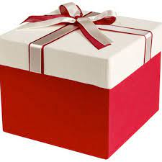
LUCKY NUMBER!

Slide 10
LUCKY NUMBER!

Slide 11
1. It’s good if children help their parents with the housework.
→ Children should………………………………………………
help their parents with the housework

Slide 12
2. It’s not a good idea when you eat a lot of sweets and candies.
→ You shouldn’t……………………………………………..
eat a lot of sweets and candies.

Slide 13
3. I’m not happy when children lie to their parents.
→ Children shouldn’t………………………………………………
lie to their parents.

Slide 14
4. She doesn’t have any new books in the bag
→ There …………………………………………..................
aren’t any new books in her bag.

Slide 15
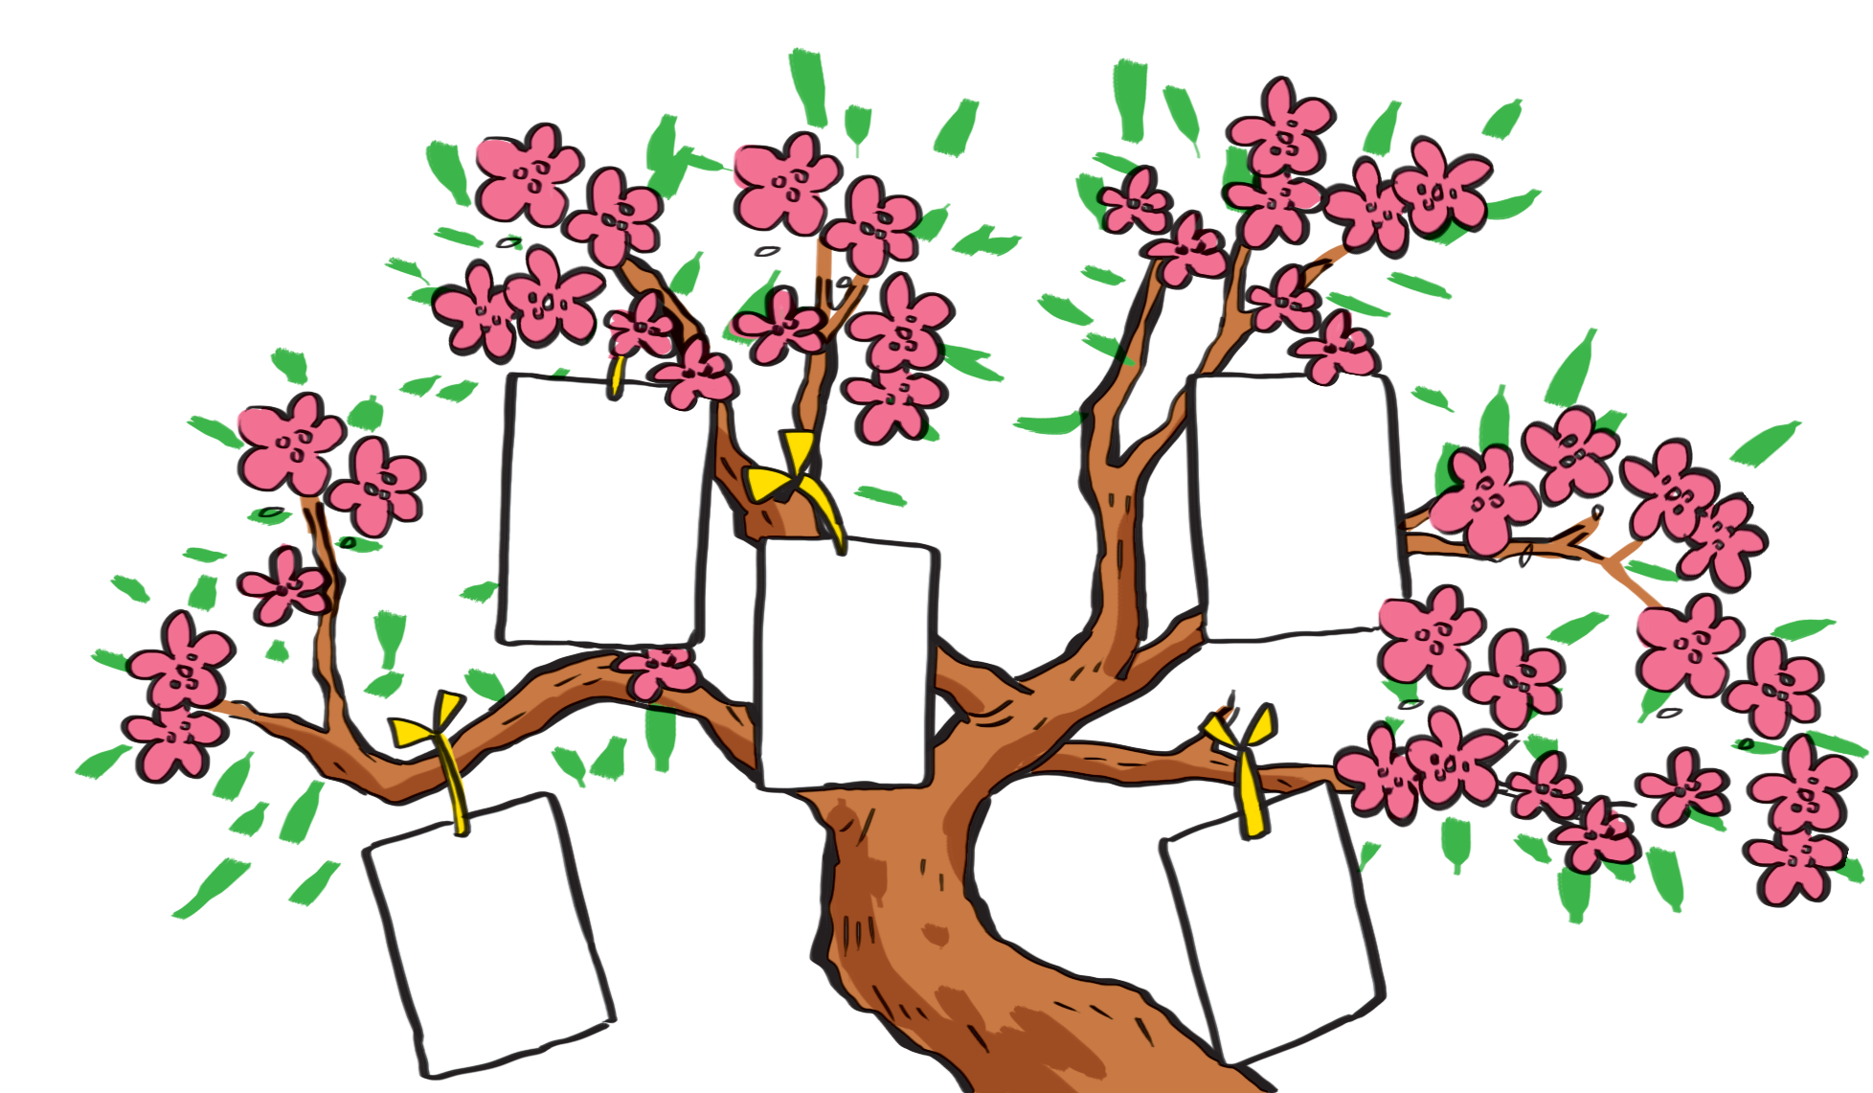
I want to have a brother.
I want to visit Singapore
I want to live in a tree house.

Slide 16
I wish
1.
Each student gets a small piece of paper and writes his / her wishes on it.
2.
He / She hangs it on a tree.
3.
Other students take turns to come up, get a piece of paper and read aloud the wish.
4.
The class guess whose wish it is.

Slide 17
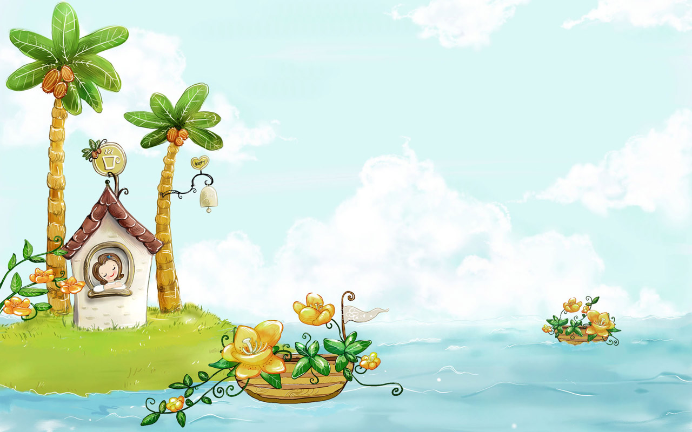
Homework:
-Practice vocabulary and pronunciation /s /and /ʃ / sounds
-Write 5 sentences to tell about the most useful things on Tet holiday
-Prepare REVIEW 2 LANGUAGE

Slide 18
Thanks for your atendance!

