Slide 1
Welcome to our class

Slide 2
1
F
A
T
H
E
R
F
Key
A
U
N
T
2
A
3
M
O
T
H
E
R
M
4
I
E
N
I
C
E
L
5
U
N
C
L
E
B
A
B
Y
6
Y
FILL IN THE BLANK:
A boy/girl is under 1 year old, especially one that has not yet begun to walk or talk is called a _____________
FILL IN THE BLANK:
A daughter of your brother or sister is called _____________
FILL IN THE BLANK:
The brother of someone's mother or father is called _____________
FILL IN THE BLANK:
The younger sister of someone's father or mother is called_________ _____________
FILL IN THE BLANK:
The person who gave birth to you is called _____________
FILL IN THE BLANK:
Daddy is another way to call a _____________

Slide 3
UNIT 6: VIET NAM NOW AND THEN
Period 46: Skills 2
Lesson plan for English 9

Slide 4
I. VOCABULARY
- private /ˈpraɪvət/ (a): riêng tư, cá nhân
- admires /ədˈmaɪə(r)/(v): ngưỡng mộ
- easy-going (a): dễ tính
- compromise /'kɔmprəmaiz/(n) sự thỏa hiệp

Slide 5
II.Listening:

Slide 6
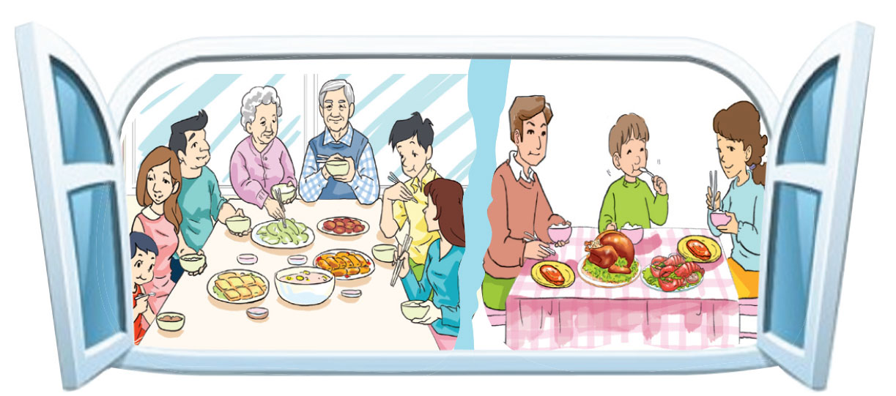
 | Picture 1 | Picture 2
Similarity | - They are family - They are having meal together
Differences | There are 3 generations: grandparents, parents and children | There are 2 generations: parents and child.

Slide 7
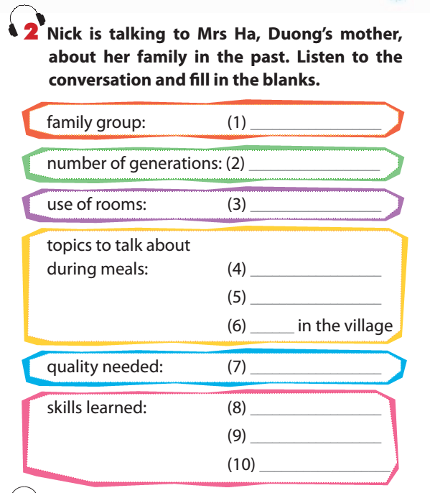
compromise

Slide 8
extended family
three generations
shared
their day
their work
things happening
to be tolerant
talk
listen
compromise

Slide 9
3. Listen again and decide if the following statements are true (T) or false (F)
 | T | F
1. Duong is living in a nuclear family
2. Each member in Duong’s family has a private rooms now
3. Nick likes the way the family shared rooms in the past
4.Nick didn’t like the way Mrs Ha’s family had meals together
5. Mrs Ha admires her grandma
6. Nick admires the way the family reached an agreement

Slide 10
3. Listen again and decide if the following statements are true (T) or false (F)
 | T | F
1. Duong is living in a nuclear family
2. Each member in Duong’s family has a private rooms now
3. Nick likes the way the family shared rooms in the past
4.Nick didn’t like the way Mrs Ha’s family had meals together
5. Mrs Ha admires her grandma
6. Nick admires the way the family reached an agreement
extended
shares most of rooms
can’t imagine
sounds it great

Slide 11
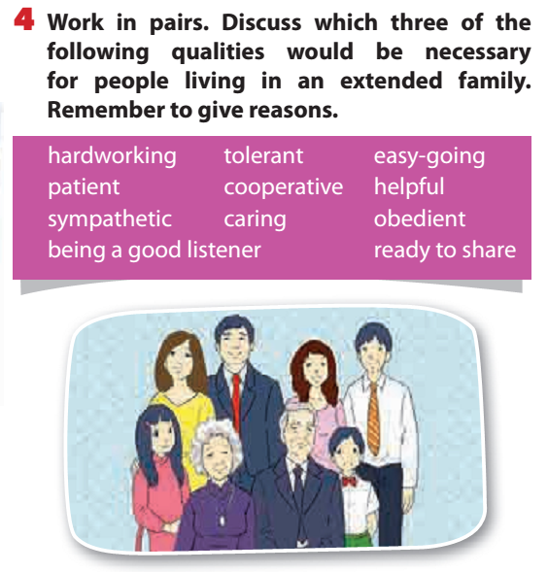
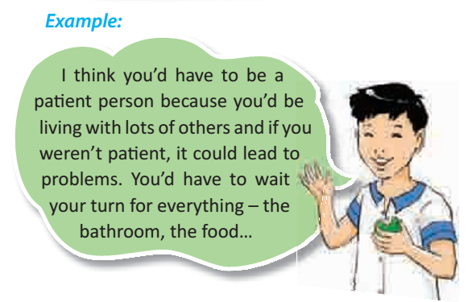
III. Writing:

Slide 12
Suggestion
I think you would have to be caring because you live with not only your parents but also your grandparents. It is important that you care for every member in your family so that the family is happy. Moreover, you also need to be sympathetic because the gaps between generations are unavoidable. In order to maintain the harmonies in the family, everyone must understand for each other and be tolerant.

Slide 13
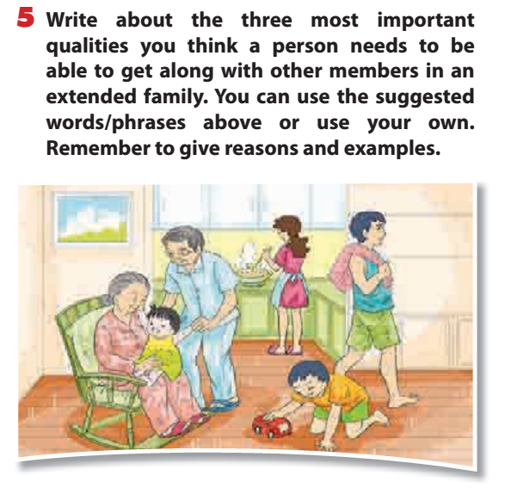

Slide 14
Suggestion
I think strong families have a sense of loyalty and devotion toward family members.
Firstly, the family sticks together. They stand by each other during times of trouble. They stand up for each other when attacked by someone outside the family.
Secondly, loyalty builds through sickness and health, want and good fortune, failure and success, and all the things the family faces.
Finally, the family is a place of shelter for individual family members. In times of personal success or defeat, the family becomes a cheering section or a mourning bench. They also learn a sense of give and take in the family
In conclusion, strong families helps prepare them for the necessary negotiations in other relationships.

Slide 15
IV. Homework:
- Learn by heart new words.
- Do all the exercises again
- Prepare Unit 2: Communication

