Slide 1


ENGLISH 6

Slide 2

Warm up: * Write the names of Tv programmes
Cartoon
The world of animals
The voice kids
Names of TV programmes
Talk show
Weekend meeting
The weather forcast
news
comedy
documentary
Game show

Slide 3
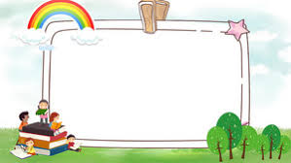
1. Do you like watching TV? Why/Why not?
2. How many hours a day do you watch TV?
3. What channel do you like best?
* Suggested answers:
1. Yes, I do. I love watching TV because it’s fun.
2. I spend about thirty minutes/ one hour a day watching TV.
3. I like Cartoon Network/ VTV3/ VTV1.

Slide 4

Unit 7:
TELEVISION
Period 55. LESSON 1
GETTING STARTED

Slide 5
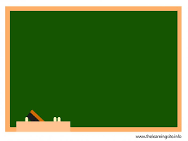



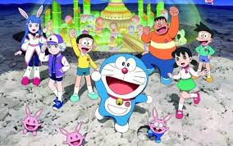
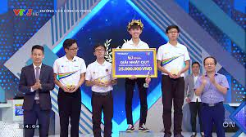
Unit 7:
TELEVISION
LESSON 1
GETTING STARTED
* Vocabulary:
- talent
(for) (n) : tài năng (về)
- programme (n)
: chương trình
- animated (adj) :
hoạt hình
- prefer (v) :
thích hơn
- character (n) :
nhân vật
- educational (adj) :
mang tính giáo dục

Slide 6
* Checking vocab
What and Where
programme
character
animated
talent
educational
prefer

Slide 7


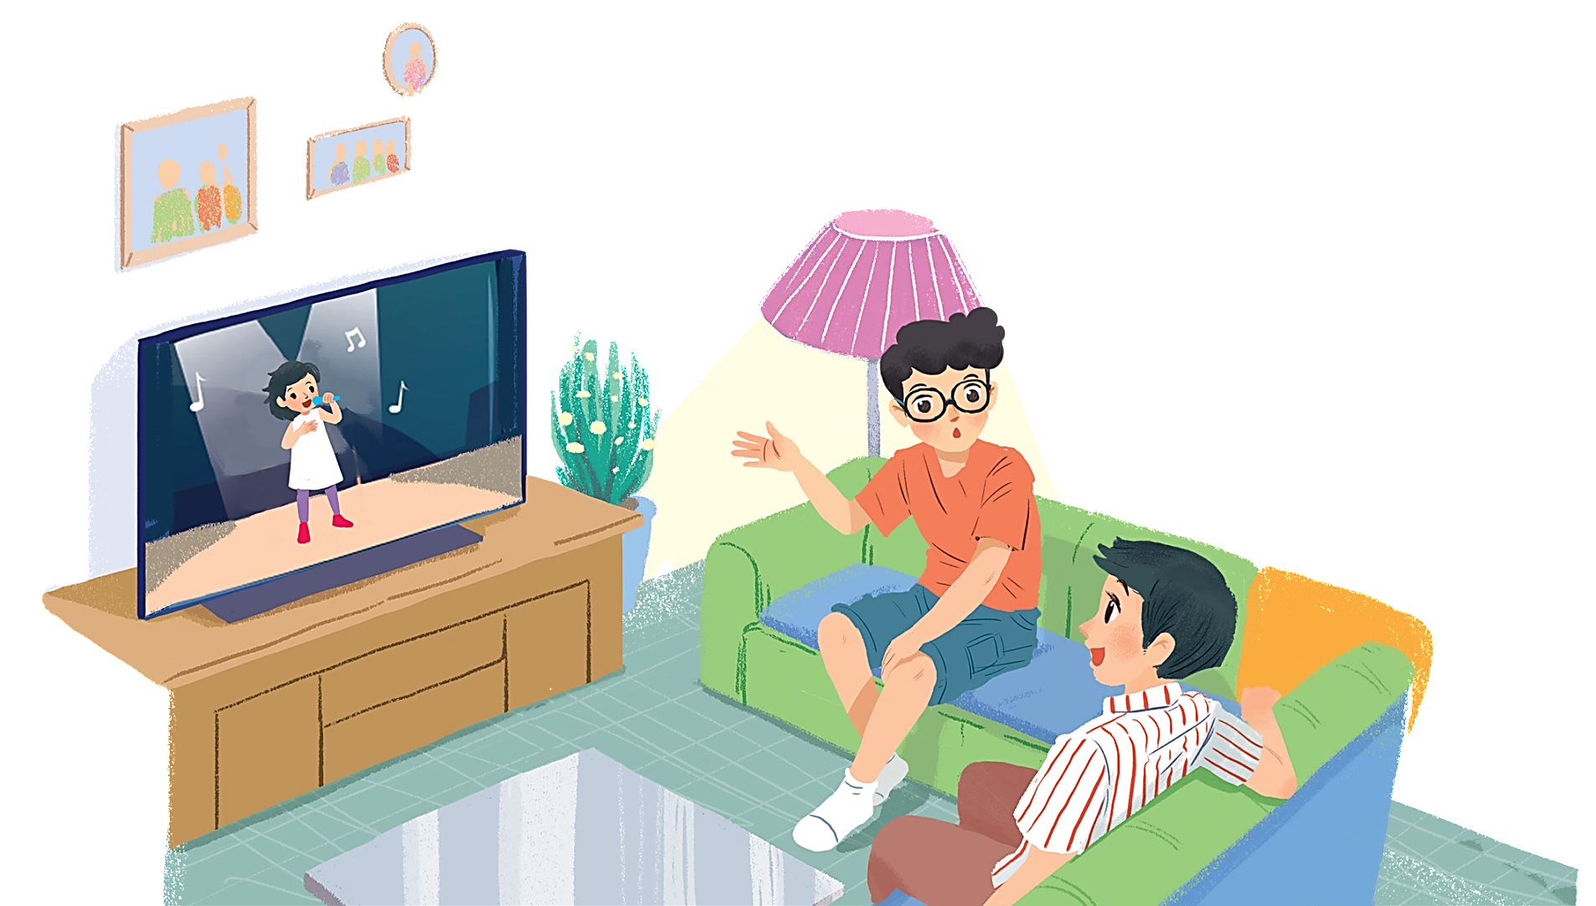
Listen and read.
What’s on today?
a) Who are they in the dialogue?
b) What do you think they are talking about?
They are Phong and Hung
b) They are talking about TV shows.
(They are talking about their favourite TV programmes . )

Slide 8
What’s on today?
Phong: What are you watching, Hung?
Hung: The Voice Kids.
Phong: That music talent show is very interesting.
Hung: It is. What programme do you often watch, Phong?
Phong: Films. I like animated films like The Lion King.
Hung: I love them, too. They’re wonderful.
Phong: I often watch them with my little brother, but he prefers cartoons.
Hung: Tom and Jerry?
Phong: Ha ... ha ... Yes, he loves Jerry the mouse.
Hung: Jerry’s a clever character. Do you know any English programmes for children?
Phong: Yes. I watch English in a Minute on VTV7.
This channel has many educational programmes.
Hung: Great. I’ll watch it, too.

Slide 9

Choose the correct answer A, B, or C.
1.
Phong and Hung are talking about _______.
A.
The Voice Kids programme
B.
English in a Minute programme
C.
different TV programmes
2.
Phong likes _______.
A.
animated films
B.
cartoons
C.
talent shows
3.
When you’re viewing a TV programme, you say: “I’m _______ TV.”
B.
C.
looking
A.
watching
seeing
4.
When a programme teachesyou something, it’s _______.
A.
educational
B.
funny
C.
clever

Slide 10

Read the conversation again and match 1-5 with a-e.
1. The Voice Kids
2. The Lion King
3. Tom and Jery
4. VTV7
5. English in a Minute
a. animated film
b. channel
c. music talent show
d. educational programme
e. cartoon
* Answer key:
1. c 2. a 3. e 4. b 5. d

Slide 11

Find and write the adjectives in the conversation which describe the programmes and characters below.
1.
The Voice Kids
2.
animated films
3.
Jerry the mouse
4.
programmes on VTV7
Game: THE BIG WHEEL GAME

Slide 12
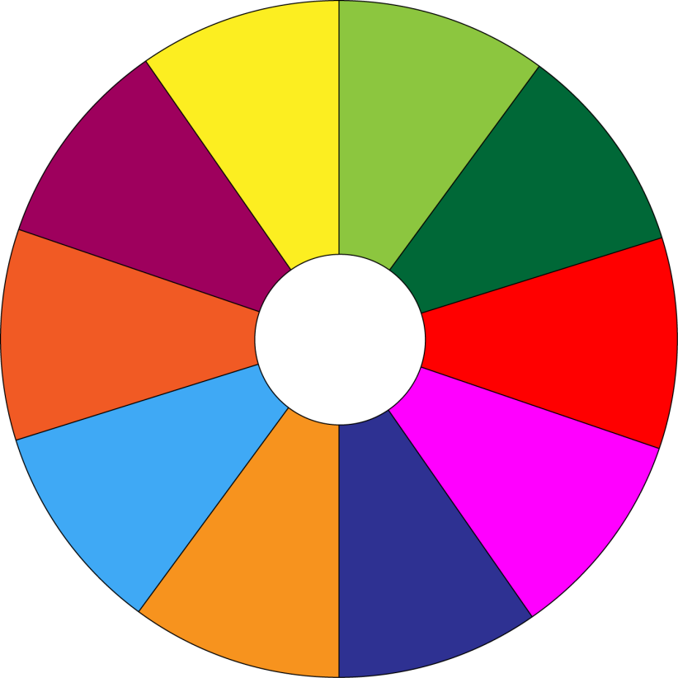
THE BIG WHEEL GAME
QUESTIONS
1
10
40
30
50
2
SPIN
20
10
3
-15
-20
05
60
4

Slide 13
Find and write the adjectives in the conversation which describe the programmes and characters below.
1.
The Voice Kids
interesting
2.
animated films
wonderful
3.
Jerry the mouse
clever
4.
programmes on VTV7
educational

Slide 14
Find and write the adjectives in the conversation which describe the programmes and characters below.
1.
The Voice Kids
interesting
2.
animated films
wonderful
3.
Jerry the mouse
clever
4.
programmes on VTV7
educational

Slide 15


Work in groups. Interview your partners about their favourite TV programmes and report to the class.
Example:
In our group, Mai likes sports programmes on TV. Binh likes ...
e.g. Hung likes sports programmes on TV. Lan likes music talent shows. Binh likes Khoi likes cartoons and Hoa likes English programmes.

Slide 16

Exercise . Use the suitable words to complete the sentences
comedy
1. I like………….........programmes. They make me laugh
channels
2. The most popular TV……………in Viet Nam are VTV1 and VTV3
Cartoons
3. …………….often use animals as the main characters
educational
4. A(n)…………….programme can always teach children something
animated
5. I like …………….films like The Lion King.
1
16

Slide 17



Homework
Prepare : lesson 2 ( A closer look 1.
Learn the new words by heart.
Do exercise in workbook..
Good bye !

