Slide 1
Welcome to our class
Unit 7
RECIPES AND EATING HABITS
P. 59- Lesson 5: skills 1

Slide 2
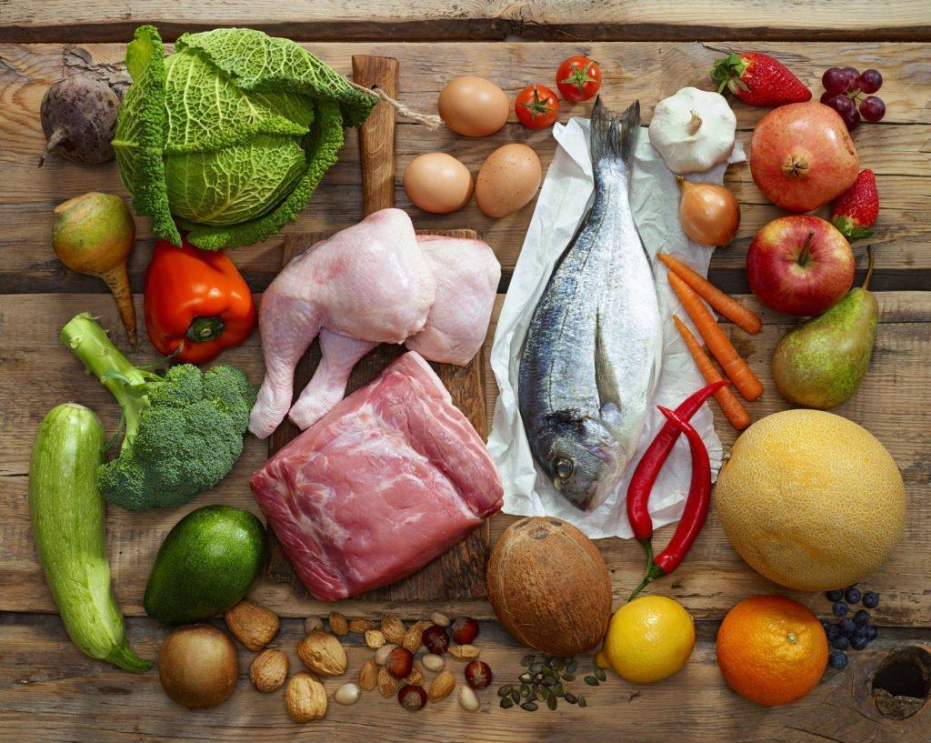
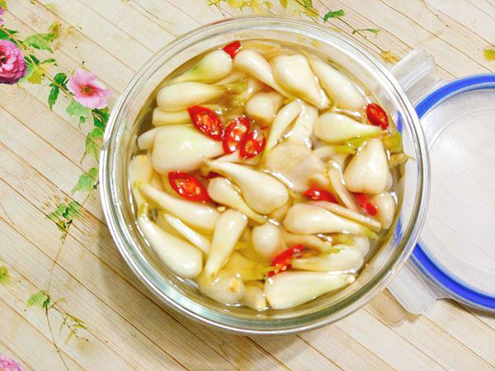
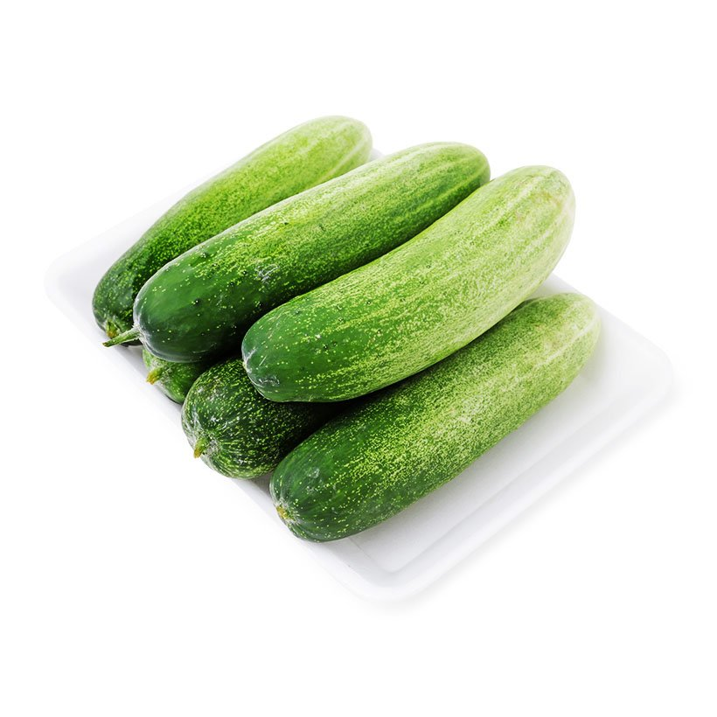
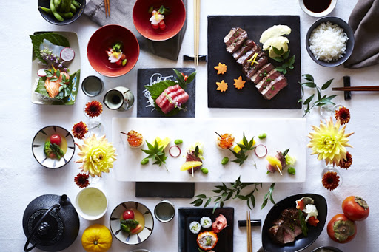
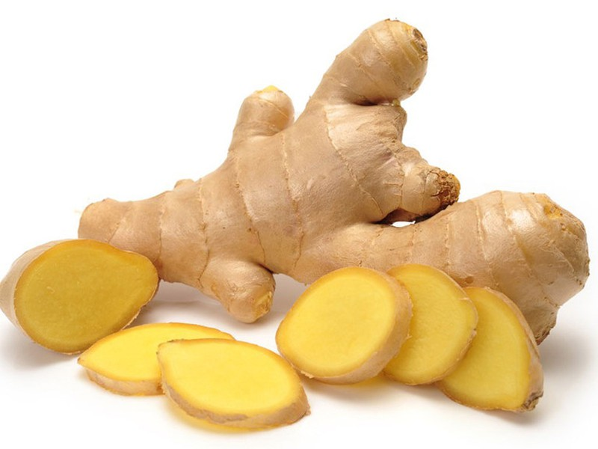
I. VOCABULARY
- arrange dish:
bài trí món ăn
- raw food:
đồ ăn tươi sống
- component (n)
thành phần
- ‘typically (adv):
một cách đặc trưng
- pickles (n):
dưa hành muối
- eating habit:
thói quen ăn uống
- portion (n):
khẩu phần
- soy sauce:
nước tương
- ‘cucumber (n):
dưa chuột
- ginger (n):
gừng

Slide 3
I. VOCABULARY
- arrange dish /əˈreɪndʒ/ :
Sắp xếp bài trí món ăn
- raw food:
đồ ăn tươi sống
- component /kəm'pounənt/ (n):
thành phần
- typically (adv):
một cách đặc trưng
- pickles /'pikl/(n):
dưa hành muối
- eating habit:
thói quen ăn uống
- portion /'pɔ:ʃn/ (n):
khẩu phần
- soy sauce /ˌsɔɪ ˈsɔːs/ :
nước tương
- cucumber /'kju:kəmbə/ (n):
dưa chuột
- ginger /'dʤindʤə/ (n):
gừng

Slide 4
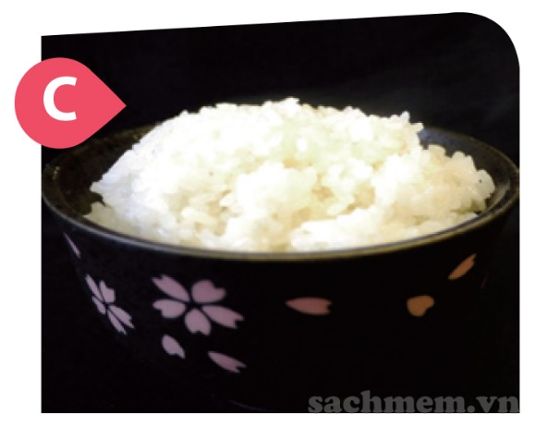
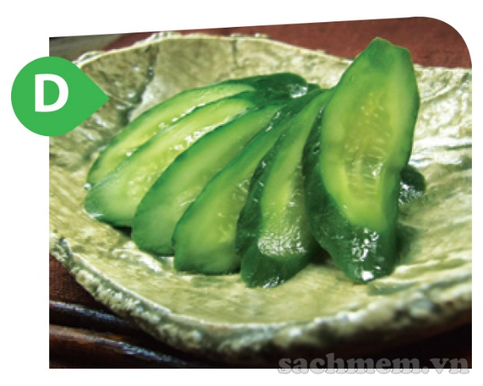
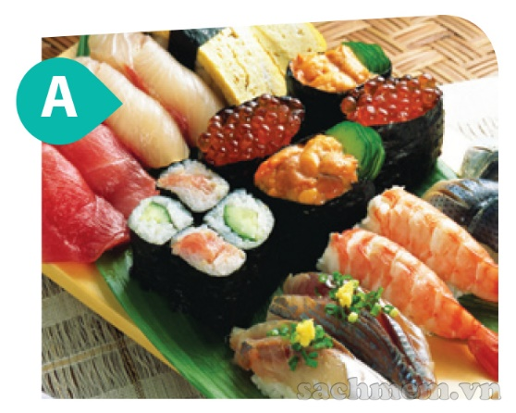
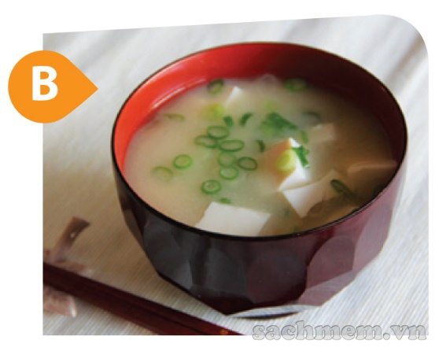
II. READING
1. Work in pairs. Answer the questions.
2. Have you ever tried the dishes in the pictures? If so, how did you find them?
1. What can you see in each picture?
Picture A: different types of sushi
I have never tried the dishes.
Picture B: miso soup
Picture C: a bowl of rice
Picture D: sliced cucumber/pickled cucumber

Slide 5
2. Now read an article about Japanese eating habits. Match the headings (1-3) with the paragraphs (A-C).
The art of arranging dishes.
2. The habit of having raw food and simple sauces.
3. Components in a typical Japanese meal.
A.Typically, a Japanese meal consists of rice, miso soup, the main dish(es) and pickles. Rice is the staple and plays a central part in people’s eating habits. Japanese rice is sticky and nutritious, so when combined with the main dishes and the soup, they make a complete meal. The portions of each dish are individually served.
3. Components in a typical Japanese meal
B. The most important characteristic of their eating habits is they like raw food and do not use sauces with a strong flavour. Two typical examples are sashimi and sushi. The Japanese make sashimi simply by cutting fresh fish. Then they serve it with a dipping sauce made from soy sauce and spicy Japanese horseradish (wasabi). Sushi is similar. The cooked, vinegared rice can be combined with raw fish, prawn, avocado, cucumber or egg. Sushi is usually served with soy sauce and pickled ginger.
2. The habit of having raw food and simple sauces
C. It is said that the Japanese eat with their eyes. Therefore, the arrangement of dishes is another significant feature of their eating habits. If you join a Japanese meal, you may be excited to see how the colourful dishes are arranged according to a traditional pattern. In addition, there are plates and bowls of different sizes and designs. They are carefully presented to match the food they carry.
1. The art of arranging dishes

Slide 6
2. Now read an article about Japanese eating habits. Match the headings (1-3) with the paragraphs (A-C).
The art of arranging dishes.
2. The habit of having raw food and simple sauces.
3. Components in a typical Japanese meal.
A.Typically, a Japanese meal consists of rice, miso soup, the main dish(es) and pickles. Rice is the staple and plays a central part in people’s eating habits. Japanese rice is sticky and nutritious, so when combined with the main dishes and the soup, they make a complete meal. The portions of each dish are individually served.

Slide 7
2. Now read an article about Japanese eating habits. Match the headings (1-3) with the paragraphs (A-C).
The art of arranging dishes.
2. The habit of having raw food and simple sauces.
3. Components in a typical Japanese meal.
B. The most important characteristic of their eating habits is they like raw food and do not use sauces with a strong flavour. Two typical examples are sashimi and sushi. The Japanese make sashimi simply by cutting fresh fish. Then they serve it with a dipping sauce made from soy sauce and spicy Japanese horseradish (wasabi). Sushi is similar. The cooked, vinegared rice can be combined with raw fish, prawn, avocado, cucumber or egg. Sushi is usually served with soy sauce and pickled ginger.

Slide 8
2. Now read an article about Japanese eating habits. Match the headings (1-3) with the paragraphs (A-C).
The art of arranging dishes.
2. The habit of having raw food and simple sauces.
3. Components in a typical Japanese meal.
C. It is said that the Japanese eat with their eyes. Therefore, the arrangement of dishes is another significant feature of their eating habits. If you join a Japanese meal, you may be excited to see how the colourful dishes are arranged according to a traditional pattern. In addition, there are plates and bowls of different sizes and designs. They are carefully presented to match the food they carry.

Slide 9
3. Read the article again and answer the questions.
1. What is the most important feature of Japanese eating habits?
=> They like raw food and do not use sauces with a strong flavour.
2. How do they make sashimi?
=> They cut fresh fish.
3. What sauce can both sashimi and sushi be served with?
=> Both can be served with soy sauce.
4. How many components are there in a typical Japanese meal?
There are four (rice, miso soup, main dish(es), pickles).
5.How is rice important in Japanese meals?
=> Rice is the staple food and is very nutritious.
6.Why do people say that the Japanese eat with their eyes?
=> Because the dishes are presented in different bowls and plates, and are arranged carefully according to a traditional pattern.

Slide 10
III. SPEAKING

Slide 11
4. Work in groups. Discuss the eating habits of Vietnamese people. You can use the following questions as cues.
1.What is the most important feature of Vietnamese eating habits?
6. In general, do Vietnamese people have healthy eating habits?
⇒ Vietnamese people usually have big dinner with at least 3 dishes and use many kinds of special sauces for each dish.
⇒ Yes, because we eat a lot of vegetables and fruits.
2. What are the typical components in a Vietnamese meal ?
⇒ Rice is the typical components in a Vietnamese meal.
3. What is the staple of our country?
⇒ Rice is the staple.
4. How are the dishes arranged?
⇒A tray of food with a small bowl of sauce in the middle.
5. Are there any other characteristics of our eating habits that you know?
⇒ Vegetable and soup are two dishes that always appear in a typical Vietnamese meal; after a meal, we usually eat fruit for desserts.

Slide 12
5. Imagine that you take part in an international competition in which competitors talk about the eating habits of their own country. Present your group's ideas about Vietnamese eating habits.
Vietnamese eating habits
Vietnamese food is varied and distinctive. It is considerably low fat and high in carbohydrates. Traditional Vietnamese cooking usually uses fresh ingredients, little dairy and oil, and various herbs and vegetables. Different sauces such as fish sauce, shrimp paste, and soya sauce are quite popular in various regions. There is no concept of ‘courses’ in a Vietnamese meal. A meal consists of various dishes: main dish (meat, fish, egg or tofu), vegetable, soup and rice. Rice is the staple in Viet Nam. In many families, people eat around a tray of food with a small bowl of fish sauce in the middle. Around this bowl are the dishes. If people place the food on a table, a similar arrangement is followed. Dishes are served communally. Usually there is a big dish/bowl of each dish, and people use chopsticks and spoons to get their share. In general, Vietnamese food is considered healthy and is popular in other countries.

Slide 13
IV. PRODUCTION

