Slide 2
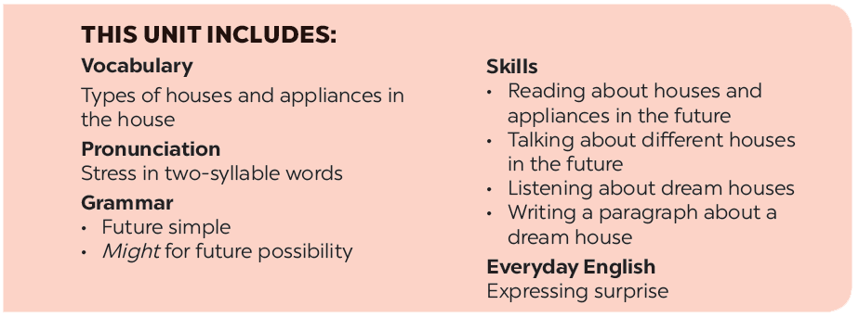

Slide 3
Reading
Speaking
Look at the picture and discuss it with a partner.
Work in pairs. Ask your partner about his / her future house. Use the suggested questions.
Read the text and match the beginnings in A with the endings in B.
Work in groups. Tell your partners about your future house. You can use the information in 4.
Read the text again and circle the option (A, B, or C) to complete the sentences.

Slide 4
Reading

Slide 5
I. VOCABULARY
1. contact (v):
Tiếp xúc, liên lạc
2. surround:
Bao quanh, vây quanh
3. planet (n):
Hành tinh
4. cottage (n):
Nhà tranh
5.‘helicopter (n):
Máy bay trực thăng
6. wash clothes:
giặt quần áo
7. send and receive:
Gửi và nhận
8. wireless :
Vô tuyến, không dây
9. feed (v)
Cho ăn, nuôi

Slide 6
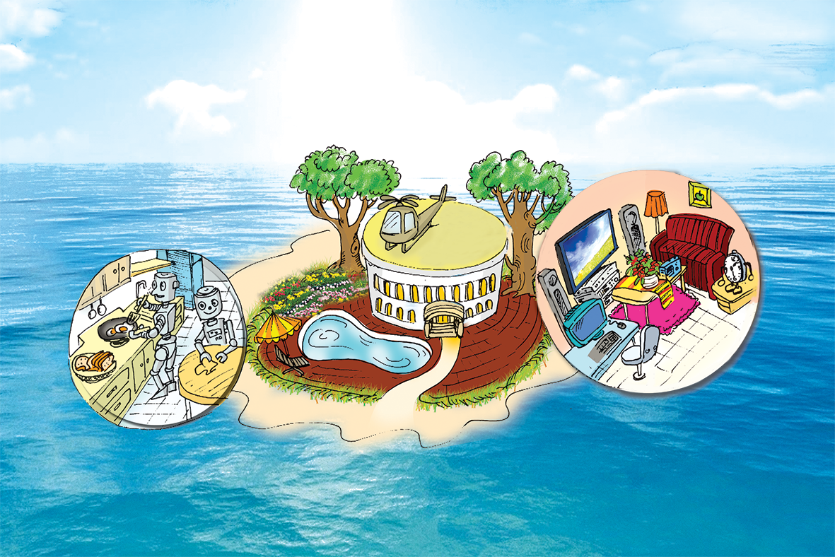
Look at the picture and discuss it with a partner.
1.
What type of house do you think it is?
2.
Where do you think the house is?
E.g.
A: What type of house do you think it is?
B: I think it’s a villa.
A: Where do you think it is?
B: I think it’s on an island.

Slide 7
Read the dialogue quickly to check your ideas in 1.
My future house will be on an island. It will be surrounded by tall trees and the blue sea. There will be a swimming pool in front of the house. There will be a helicopter on the roof. I can ﬂy to school in it.
There will be some robots in the house. They will help me to clean the ﬂoors, cook meals, wash clothes and water the ﬂowers. They will also help me to feed the dogs and cats.
There will be a super smart TV. It will help me to send and receive emails, and contact my friends on other planets. It will also help me to buy food from the supermarket.

Slide 8
A
B
a. clean the floors.
c. wash clothes.
e. cook meals.
g. feed the dogs and cats
h. water the flowers.
b. contact my friends.
d. buy food from the supermarket.
f. send and receive emails.
B
a. clean the floors.
b. contact my friends.
1.
The house will have robots to
c. wash clothes.
d. buy food from the supermarket.
e. cook meals.
2.
The house will have a super smart TV to
f. send and receive emails.
g. feed the dogs and cats.
h. water the flowers.

Slide 9
Read the text again and circle the option (A, B, or C) to complete the sentences.
1.
The house will be _______.
A.
in the mountains
B.
on an island
C.
on the Moon
2.
There will be a _______ in front of the house.
A.
garden
B.
pond
C.
swimming pool
3.
The house will have _______ robots.
A.
B.
some
many
C.
a lot of
4.
The _______ will help me to feed the dogs and cats.
A.
helicopter
B.
robot
C.
super smart tv

Slide 10
Speaking

Slide 11
Work in pairs. Ask your partner about his / her future house. Use the suggested questions.
Example:
A: What type of future house do you think it will be?
B: It’ll be a palace.

Slide 12
1.
What type of future house do you think it will be?
2.
Where will it be?
3.
What will it look like?
4.
How many rooms will it have?
5.
What appliances will it have and what will they help you to do?

Slide 13
Choose one sportsperson in 4. Talk about him / her. Use the following cues.
Example:
My future house will be a palace.It’ll be on the Moon. There’ll be a super smart TV in the house. It’ll help me to talk to my friends on other planets.

