Slide 1
UNIT 9: ENGLISH IN THE WORLD
Period : 70
Lesson 2: A closer look 1
I. Vocabulary
Language use and learning
II. Pronunciation
Tone in new and known information

Slide 2
I. NEW WORDS:
1. Words about language learning
Bilingual /ˌbaɪˈlɪŋɡwəl/(adj) : song ngữ, hai thứ tiếng
ﬂuent (adj) /ˈﬂ uːənt/: trôi chảy
Pick up (a language) (v) /pɪk ʌp/: học ngôn ngữ theo cách tự nhiên từ môi trường xung quanh, học lỏm
Get by in (a language) (vp) /get baɪ ɪn/ : biết sơ sơ, biết đủ dung
rusty (adj) /ˈrʌsti/: giảm đi do lâu không thực hành/sử dụng, mai một
reasonably (adv) /ˈriːznəbli/ : vừa phải, hợp lý, khá tốt
Imitate(v): bắt chước

Slide 3
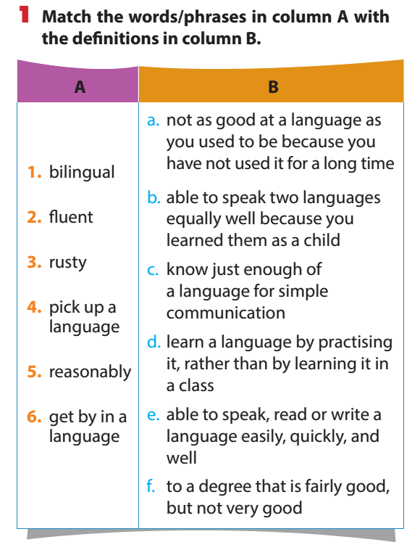

Slide 6
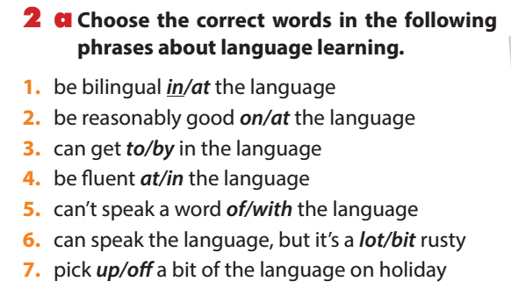

Slide 9
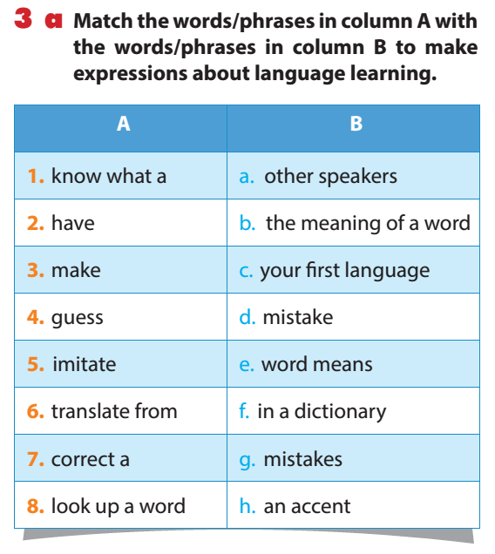

Slide 11
If you don’t (1) ________ what a word means, try to (2) ________ the meaning, or (3) ________ the word in your dictionary. All foreign speakers (4) ________ an accent, but that doesn’t matter. To make your pronunciation better, listen to English speakers and try to (5) ________ them. Don’t worry if you (6) ________ mistakes or don’t try to (7) ________ a mistake – that’s normal! It’s often useful to (8) ________ words from one language to the other, but it’s best when you can start to think in the new language.

Slide 12
If you don’t (1) ________ what a word means, try to (2) ________ the meaning, or (3) ________ the word in your dictionary. All foreign speakers (4) ________ an accent, but that doesn’t matter. To make your pronunciation better, listen to English speakers and try to (5) ________ them. Don’t worry if you (6) ________ mistakes or don’t try to (7) ________ a mistake – that’s normal! It’s often useful to (8) ________ words from one language to the other, but it’s best when you can start to think in the new language.
know
guess
look up
have
imitate
make
correct
translate

Slide 14
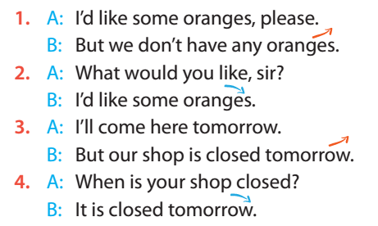

Slide 15
Remember
- New information:
Something hasn’t mentioned before.
- Voice: goes down
- Known information:
Something has mentioned before.
- Voice: goes up

Slide 16
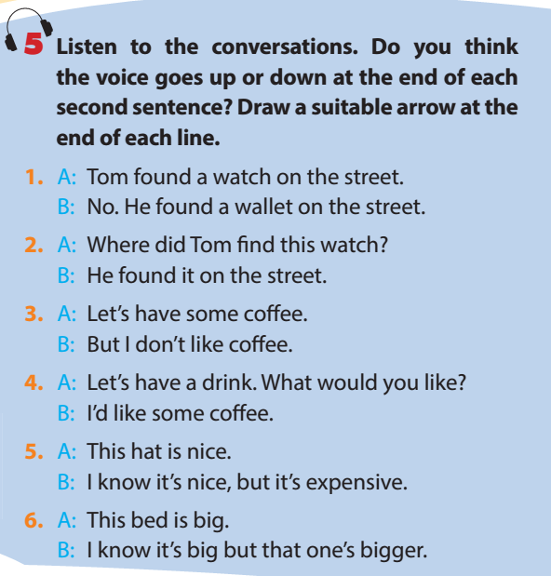

Slide 17
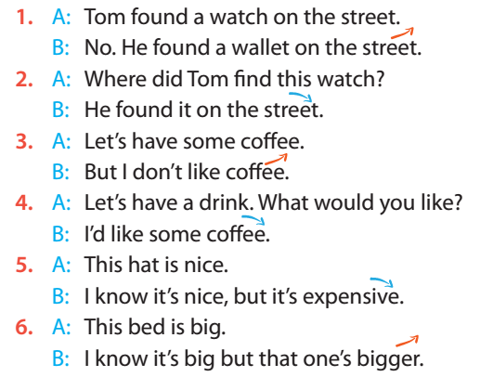

Slide 18
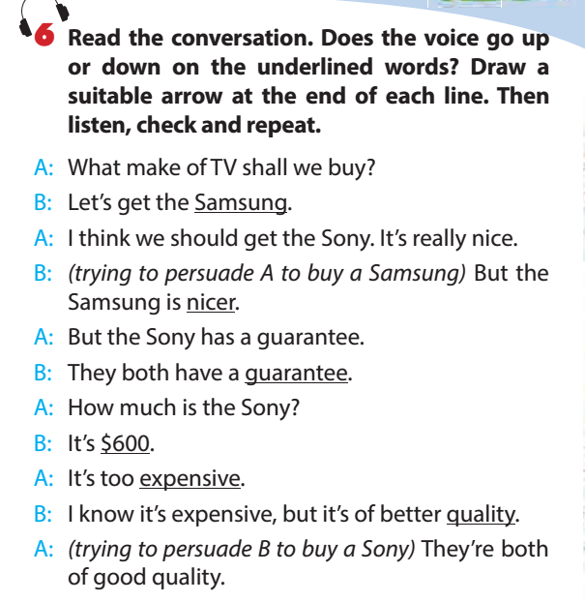

Slide 19
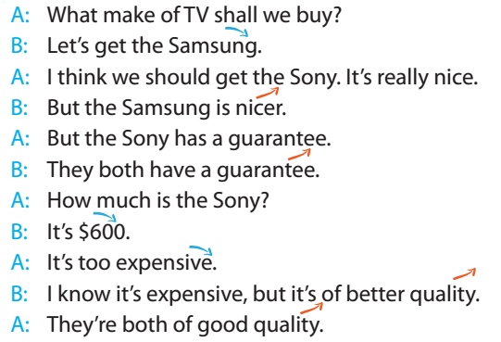

Slide 20
UNIT 9: ENGLISH IN THE WORLD Period 69: Lesson 2: A closer look 1
Vocabulary:Language use and learning: Words, phrases and expressions.
2. Pronunciation
Tone in new and known information
3. Homework
Learn by heart the new wordsand make sentences with them
Do Ex 1,2(P20), 1,2,3(P21)

