Slide 1
WELCOME  TO  OUR  CLASS
ENGLISH 6
Unit 2:
MY HOUSE
Teacher: Vo Thi Huong

Slide 2
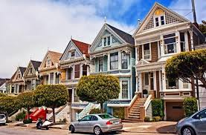
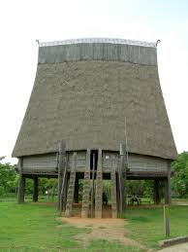
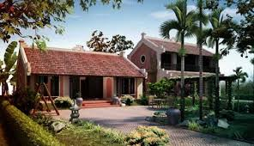
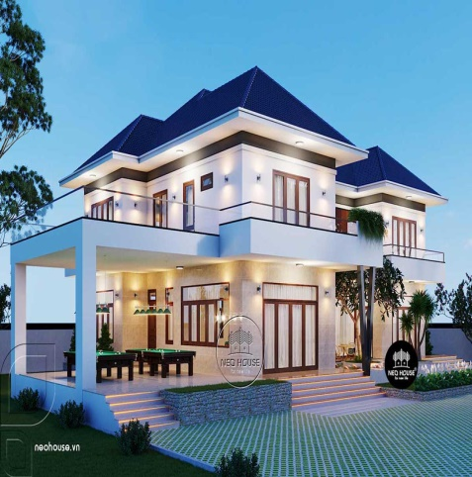
Warm up:
Game:Pelmanism
1
2
3
4
TYPES OF HOUSE
stilt house
villa
town
house
country house
5
6
7
8

Slide 3
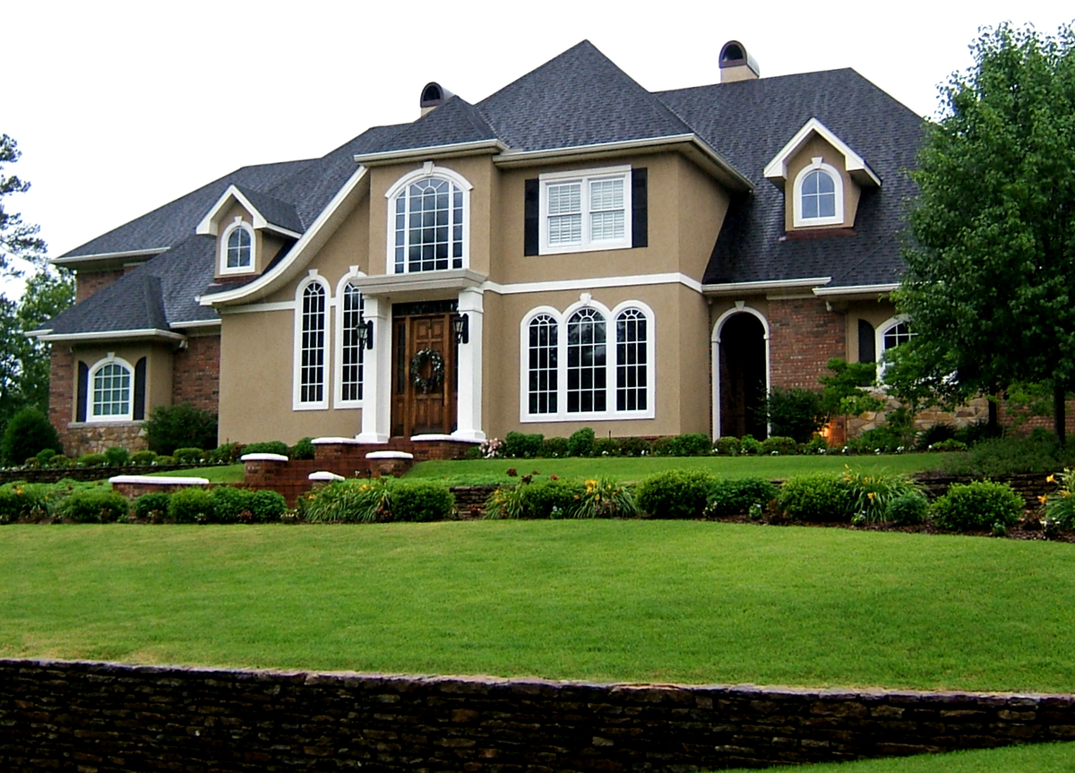
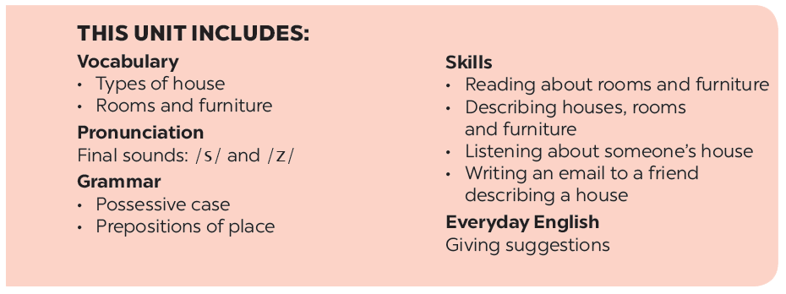
UNIT 2: MY HOUSE
LESSON 1

Slide 4
UNIT 2: MY HOUSE
PERIOD 9.LESSON 1

Slide 5
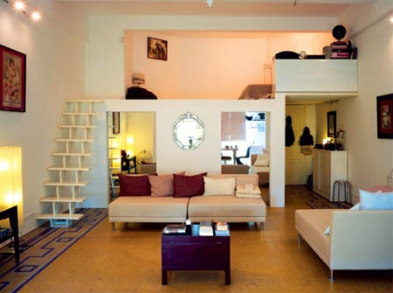
* Vocabulary.
- flat (n) : căn hộ
- country house (phr. n): nhà ở quê
- town house (phr. n) : nhà ở phố
- behind (prep) :
ở đằng sau
- cousin (n):
anh,chị ,em họ
- move (v):
di chuyển

Slide 6
* CHECKING WORDS.
MATCHING
1. flat :
a. đằng sau
2. country house
b. nhà ở phố
3. town house
c. nhà ở quê
4. behind
d. di chuyển
5. cousin
e. anh,chị ,em họ
6. move
f. căn hộ

Slide 7
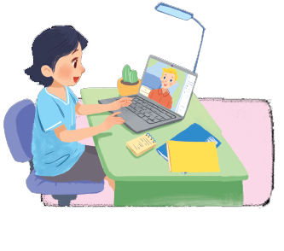
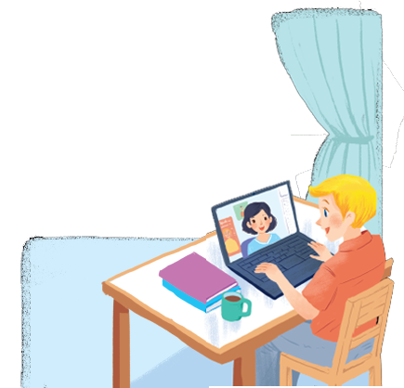
Listen and read.
A look inside
-- Who are they in the picture?
What are they doing?
What might they talk about?
Notes:
Thiếu tên bài đọc.

Slide 8
Listen and read.
A look inside
Mi: Wow! Your room looks so big, Nick.
Nick: It’s elena’s room. she’s my sister.
Mi: I see. Is there a TV behind you?
Nick: Yes, there is. Where do you live, Mi?
Mi: I live in a town house. And you?
Nick: I live in a country house. Who do you live with?
Mi: My parents and younger brother. We’re moving to a ﬂat next month!
Nick: Are you?
Mi: Yes. My aunt lives near there, and I can play with my cousin.
Nick: Are there many rooms in your new ﬂat?
Mi: Yes, there are. There’s a living room, three bedrooms, a kitchen and two bathrooms.

Slide 9
Which family members does Mi talk about?
Put a tick ().
1. | parents
2. | sister
3. | brother
4. | aunt
5. | cousin





Slide 10
Read the conversation again. Complete each sentence with ONE word.
sister
1.
Elena is Nick’s .
2.
TV
There is a in Elena’s room.
3.
Now Mi lives in a house.
town
country
4.
Nick lives in a house.
5.
Mi’s new flat has bedrooms.
three

Slide 11
Complete the word web. Use the words from the conversation and the ones you know.
town house
TYPES OF HOUSE

Slide 12
4. Complete the word web
villa
stilt house
town house
TYPES OF HOUSE
country house
farmhouse
Cottage : nhà tranh
castle
flat

Slide 13
Work in groups. Ask your friends where they live. Then report their answers.
A: Where do you live?
B: I live in a small house in the countryside.

Slide 14
*Presentation
Hello everybody. In my group. Lan lives in a country house. Nam and Quang live in flats,….

Slide 15
Homework
Learn by heart vocab.
- Learn how to pronoun / s/ and /es/.
- Prepare “ A closer look 2”

Slide 16
Goodbye!
See you again!

