Slide 1

WELCOME TO OUR CLASS
ENGLISH 6
UNIT 4: MY NEIGHBOURHOOD

Slide 2

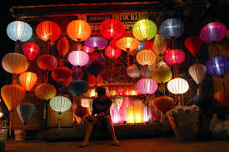
*
Warm-up: Chatting
1.Do you know where it is?
2. Have you ever been to Hoi An?
3. Do you remember anything special in Hoi An?

Slide 3
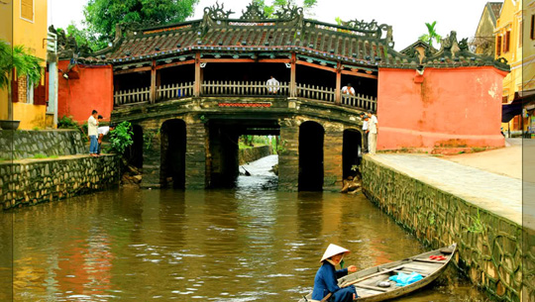
UNIT 4: MY NEIGHBOURHOOD
P26: Lesson 1: Getting started
– Lost in the old town!
Chua Cau

Slide 4
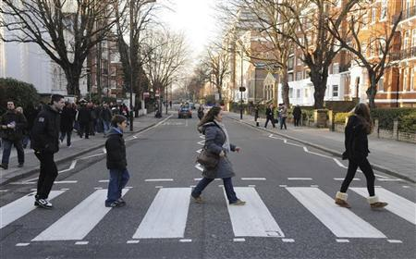



I. Vocabulary:
- Cross the road
= băng qua đường
- Turn right / left
= rẽ phải / trái
- Go / keep straight
= đi thẳng
- neighbourhood (n):
Khu xóm giềng
- to be/get lost:
bị lạc

Slide 5
Checking words:
- Cross the road
= băng qua đường
- Turn right / left
= rẽ phải / trái
- Go / keep straight
= đi thẳng
- neighbourhood (n):/'neibəhʊd/:
Khu xóm giềng
- to be/get lost:
bị lạc

Slide 6


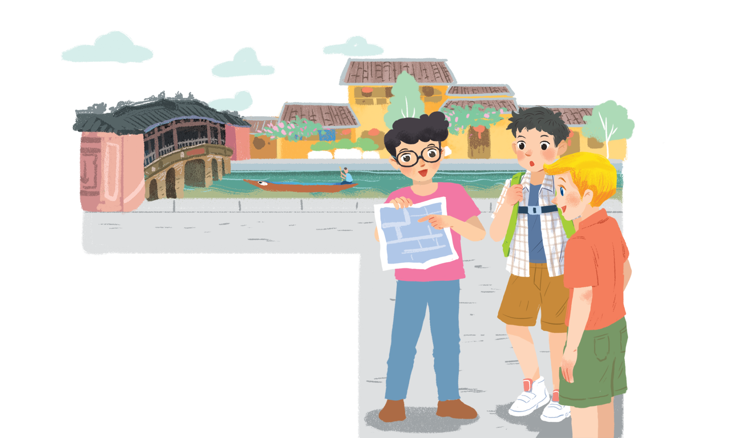
Listen and read.
Lost in the old town!
1. What are Nick, Phong and Khang doing?
2. Where are they?
3. What might be happening to them?
4. Have you ever got lost?
5. How did you feel? What did you do?
Notes:
Thiếu tên bài đọc.

Slide 7
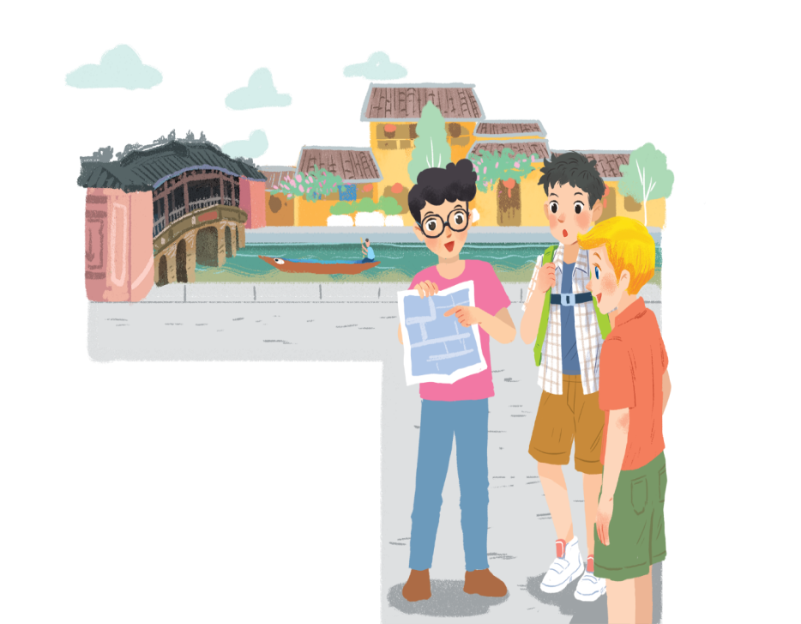
Lost in the old town!
Phong: Wow! We’re in Hoi An. I’m so excited.
Nick: Me too. It’s so beautiful. Where shall we go first?
Khang: Let’s go to Chua Cau.
Phong: Well, but Tan Ky house is nearer. Shall we go there first?
Nick & Khang: OK, sure.
Phong: First, cross the road, and then turn left.
Nick: Fine, let’s go.
Phong: Wait.
Khang: What’s up, Phong?
Phong: I think we’re lost.
Nick: Look, there’s a girl. Let’s ask her.
Phong: Excuse me? Can you tell us the way to Tan Ky House?
Girl: Sure. Go straight. Take the second turning on the left, and then turn right.
Phong, Nick & Khang: Thank you.

Slide 8

Find in the conversation the sentences used to make suggestions.
Example:
Let’s go to Chua Cau.
Phong: Wow! We’re in Hoi An. I’m so excited.
Nick: Me too. It’s so beautiful. Where shall we go first?
Khang: Let’s go to Chua Cau.
Phong: Well, but Tan Ky house is nearer. Shall we go there first?
Nick & Khang: OK, sure.
Phong: First, cross the road, and then turn left.
Nick: Fine, let’s go.
Phong: Wait.
Khang: What’s up, Phong?
Phong: I think we’re lost.
Nick: Look, there’s a girl. Let’s ask her.
Phong: Excuse me? Can you tell us the way to Tan Ky House?
Girl: Sure. Go straight. Take the second turning on the left, and then turn right.
Phong, Nick & Khang: Thank you.

Slide 9

Find in the conversation the sentences used to make suggestions.
Example:
Let’s go to Chua Cau.
We can use shall we and let’s to make suggestions.

Slide 10

Read the conversation again.
Put the actions in order.
a.
The girl shows them the way to Tan Ky House.
5
b.
Nick, Khang and Phong arrive in Hoi An.
1
c.
Nick, Khang and Phong decide to go to Tan Ky House.
2
d.
Nick, Khang and Phong get lost.
3
e.
Phong asks a girl how to get to Tan Ky House.
4

Slide 11

Find and underline the following directions in the conversation.
A.
turn right
C.
turn left
E.
take the second turning on the left
B.
cross the road
D.
go straight

Slide 12

Lost in the old town!
Phong: Wow! We’re in Hoi An. I’m so excited.
Nick: Me too. It’s so beautiful. Where shall we go first?
Khang: Let’s go to Chua Cau.
Phong: Well, but Tan Ky house is nearer. Shall we go there first?
Nick & Khang: OK, sure.
Phong: First, cross the road, and then turn left.
Nick: Fine, let’s go.
Phong: Wait.
Khang: What’s up, Phong?
Phong: I think we’re lost.
Nick: Look, there’s a girl. Let’s ask her.
Phong: Excuse me? Can you tell us the way to Tan Ky House?
Girl: Sure. Go straight. Take the second turning on the left, and then turn right.
Phong, Nick & Khang: Thank you.

Slide 13


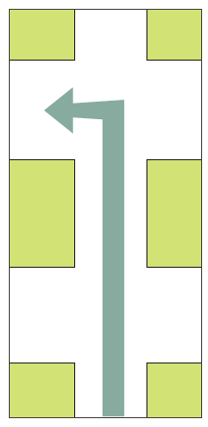


* Now match these directions with the diagrams below.
1
turn right
2
3
take the second turning on the left
cross the road
turn left
5
4
go straight
A.
turn right
C.
turn left
E.
take the second turning on the left
B.
cross the road
D.
go straight

Slide 14


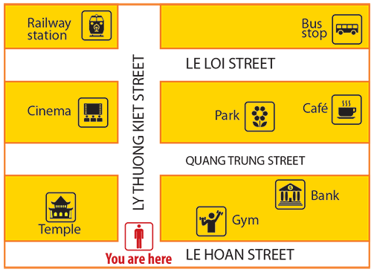
Find places
Work in pairs. Give your partner directions to one of the places on the map, and he / she tries to guess. Then swap.
Example:
A: Go straight. Take the second turning on the left. It’s on your right.
B: Is that the gym?
A: No, try again.

Slide 16


Homework:
- Learn by heart vocabulary.
- Do the exercises again.
-Be ready for A closer Look 1

Slide 17

Thank you very much.

