Slide 1
WELCOME TO OUR CLASS

Slide 2
WELCOME TO OUR CLASS
ENGLISH 6

Slide 3
WARM UP
market
bank
hospital
places
zoo
hotel
school
cinema
museum
park
stadium

Slide 4
UNIT 4: MY NEIGHBOURHOOD
Lesson 2:
PERIOD 27:
Vocabulary

Slide 5
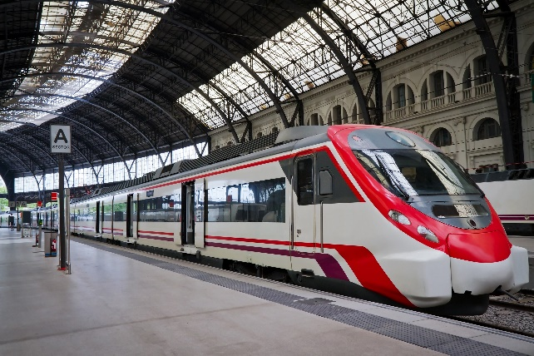
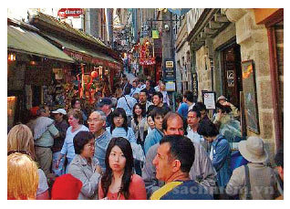
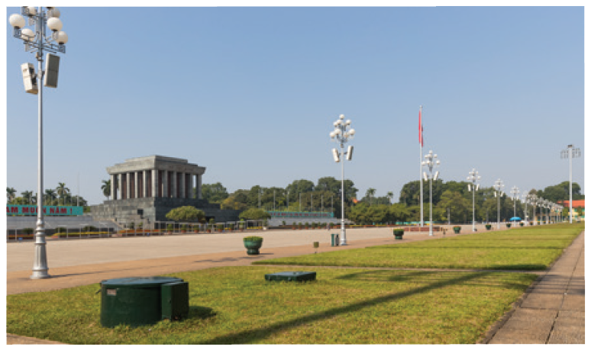
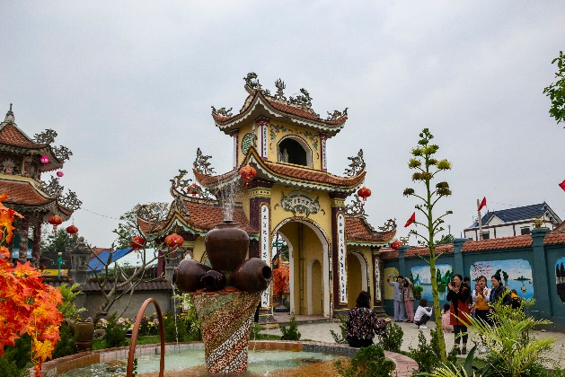
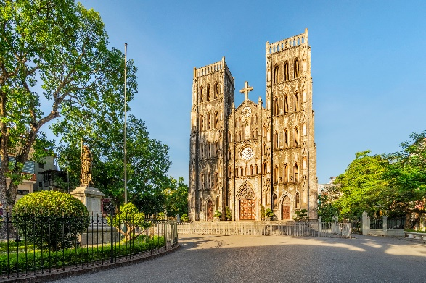
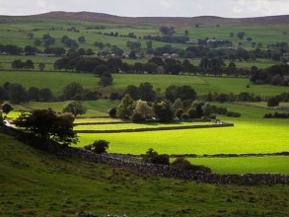
I. Vocabulary
d
quảng trường
a
- square (n): /skweə/
- cathedral (n):/kəˈθiːdrəl/
thánh đường
- railway station(n):/'reilwei/
nhà ga xe lửa
- temple (n): /ˈtempl/
ngôi đền
- crowded (adj): /kraʊdid/
đông đúc
- peaceful (adj ) /'pi:sfl/
quiet
- modern (adj)
- historic
- interesting(adj)
- boring

Slide 6
* Checking vocabulary
- square (n):
nhà ga xe lửa
- cathedral (n):
đông đúc
- railway station (n):
quảng trường
- temple (n):
historic
- crowded (adj):
thánh đường
- peaceful (adj
= quiet
- modern (adj) #
ngôi đền
- interesting(adj) #
boring

Slide 7
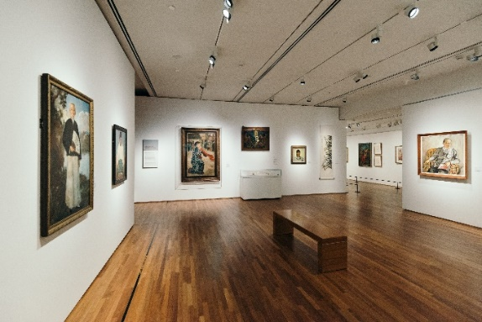
Match the places below with the pictures. Then listen, check and repeat the words.
b
b
a
1. square
2. art gallery
a
3. catherdral
4. temple
4. temple
4. temple
5. railway station
5. railway station
5. railway station
c
e
d
1. square
3. catherdral
2. art gallery

Slide 8
Name some other places in your neighbourhood.
bank
market
hospital
school
hotel
park

Slide 9
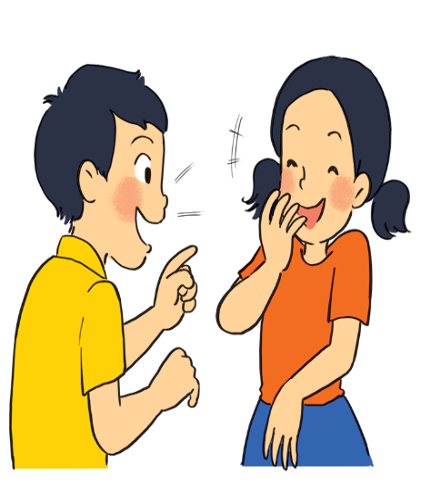
Work in pairs. Ask and answer questions about where you live.
Example:
A: Is there a square in your neighbourhood?
B: Yes, there is. / No, these isn’t.

Slide 10
Work in groups. Ask and answer about your neighbourhood. You can use the adjectives below.
noisy
busy
modern
peaceful
quiet
crowded
boring
beautiful
Example:
A: Is your neighbourhood quiet?
B: Yes, it is. / No, it’s noisy.

Slide 11
II. Pronunciation:
/ɪ/ and /i:/
Listen and repeat the words. Pay attention to the sounds /ɪ/ and /i:/.
noisy
cheap
peaceful
expensive
noisy
cheap
peaceful
expensive
clean
exciting
friendly
convenient
clean
exciting
friendly
convenient
Now, in pairs put the words in the correct column.
/ɪ/ | /i:/
noisy
convenient
expensive
cheap
exciting
peaceful
friendly
clean

Slide 12
*Give some words they know containing these sounds.
III. PRODUCTION
Suggested answers: /i/: chip, tin, ship, … /i:/: cheap, teen, sheep, …

Slide 13
Listen and practise the chant. Notice the sounds /ɪ/ and /i:/.
MY NEIGHBOURHOOD
My city is very noisy.
There are lots of trees growing. The people here are busy.
It’s a lively place to live in.
My village is very pretty.
There are lots of places to see.
The people here are friendly.
It’s a fantastic place to be.

Slide 14
IV. CONSOLIDATION

Slide 15
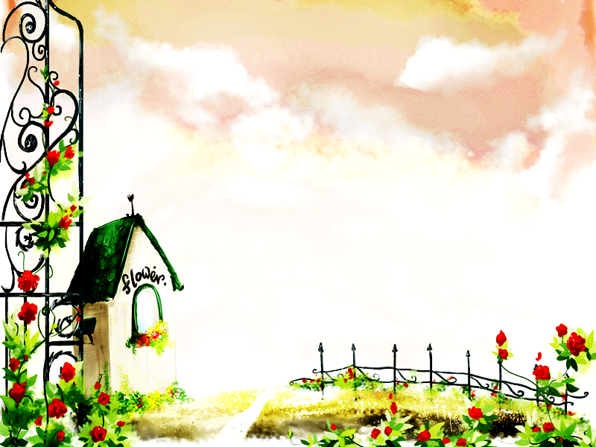
HOMEWORK
- Learn by heart Vocab.
Find 5 more words with the sound /i/
and 5 more words with the sound /i:/.
Prepare lesson 3 .

Slide 16
Thank you very much.

